Slide 1
Standard design pattern use in enterprise level using Java technologies - high level

Slide 2
Introduction to Design Patterns

Slide 3
What is a Design Pattern?
Definition and importance
History and origin (Gang of Four - GoF)
Advantages of using design patterns in software development
Common problems solved by design patterns

Slide 4
Introduction to Design Patterns

Slide 5
Definition and Importance:
Design patterns are proven, reusable solutions to common problems that developers face in software design.
Rather than starting from scratch each time, design patterns provide a template that guides the structure of code and the interaction between components.
This leads to cleaner, more maintainable, and scalable code, especially in complex applications.
Why They Matter:
Consistency: Patterns create consistency in design, making code easier for developers to understand and work with collaboratively.
Efficiency: They speed up development by reducing the need to reinvent solutions.
Quality: Patterns improve code quality by following established best practices.
Adaptability: They provide flexibility, allowing systems to be extended and modified with less risk of introducing errors.

Slide 6
History and Origin (Gang of Four - GoF):
These are design patterns which were defined by four authors
Erich Gamma
Richard Helm
Ralph Johnson and
John Vlissides in their book Design Patterns:
Their work provided a common language for developers to discuss and apply solutions to recurring design challenges.
Each pattern in the book addresses a specific problem, explaining when to use it, how to implement it, and the consequences of doing so.
The GoF patterns laid the foundation for modern software design, and their influence is seen in virtually every programming language and framework today, including Java, C#, Python, and JavaScript libraries like React.

Slide 7
Advantages of Using Design Patterns in Software Development
Improved Code Reusability
Enhanced Readability and Maintainability:
Facilitated Communication
Increased Flexibility and Scalability
Reduced Development Time and Cost
Better Code Quality and Reliability

Slide 8
Benefits & Drawbacks
Benefits:
Design patterns enable large-scale reuse of software architectures
Patterns explicitly capture expert knowledge and design tradeoffs, and make this expertise more widely available
Patterns help improve developer communication
Drawbacks:
Patterns do not lead to direct code reuse
Teams may suffer from pattern overload
Patterns are validated by experience and discussion rather than by automated testing
Notes:
Common Problems Solved by Design Patterns:
Object Creation Complexity: Patterns like Singleton, Factory, and Builder manage object creation to avoid issues like resource wastage, redundant instances, and complex object construction.
Managing Relationships Between Objects: Patterns like Observer, Mediator, and Composite help control complex inter-object dependencies and communication, reducing tight coupling and making systems more modular.
Efficient Resource Management: Singleton and Flyweight patterns handle scenarios requiring limited or shared resources, such as database connections or memory-heavy objects.
Behavioral Flexibility: Patterns like Strategy, State, and Command allow objects to change behavior at runtime, making the system adaptable and customizable without modifying existing code.
Maintaining Code Consistency and Structure: MVC (Model-View-Controller), Facade, and Adapter patterns standardize how classes are structured and interact, simplifying the code structure and enabling consistency across the application.
Improving Code Extensibility and Modularity: Decorator, Proxy, and Bridge patterns allow new functionality to be added without altering existing code, enhancing modularity and supporting future extensions.

Slide 9
Object-Oriented Design (OOD)
Encapsulation:
Definition: Encapsulation is the bundling of data (attributes) and methods (functions) that operate on that data within a single unit, usually a class. It restricts direct access to some of an object’s components, meaning the internal state of an object can only be changed through its methods.
Abstraction:
Definition: Abstraction is the process of hiding the complex details of an object and exposing only the essential parts. It allows developers to focus on what an object does rather than how it does it.

Slide 10
Object-Oriented Design (OOD)
Polymorphism:
Definition: Polymorphism is the ability of different classes to respond to the same message (method call) in different ways. It enables a single interface to represent different underlying forms (data types).
Inheritance:
Definition: Inheritance is a mechanism that allows a new class to inherit properties and behaviors (methods) from an existing class, promoting code reuse. The new class, called a subclass or derived class, inherits the attributes and methods of the superclass (parent class).

Slide 11
Solid Principles
S.O.L.I.D is an acronym for the first five object-oriented design(OOD) principles by Robert C. Martin, popularly known as Uncle Bob.
S.O.L.I.D STANDS FOR:
S – Single- Responsibility principle
O – Open-closed principle
L – Liskov substitution principle
I – Interface segregation principle
D – Dependency Inversion Principle

Slide 12
Single Responsibility Principle
S.R.P for short – this principle states that:
“A class should have one and only one reason to change, meaning that a class should have only one job.”
When we design our classes, we should take care that one class at the most is responsible for doing one task or functionality among the whole set of responsibilities that it has.
Also note that the classes defined using the Single Responsibility Principle are inherently cohesive in nature

Slide 13
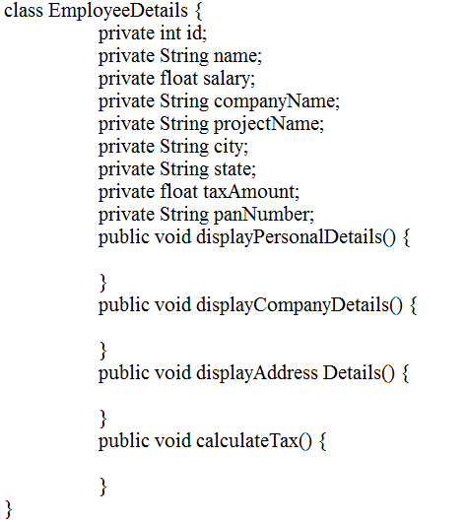

Slide 14
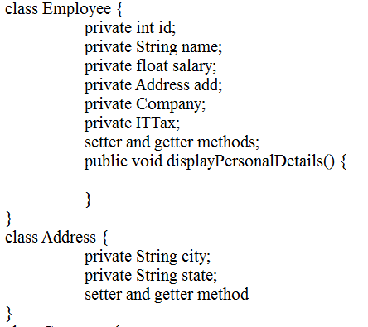
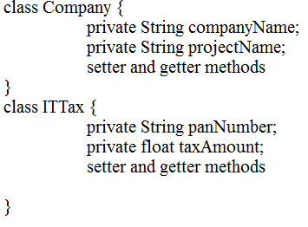

Slide 15
Open – closed Principle
“Object or entities should be open for extension, but closed for modification”
This simply means that a class should be easily extendable without modifying the class itself.
Open -> If a class is re-usable or specifically available for extending as a base class then it is “Open”.
Close -> If attributes or behaviour can be added to a class it can be said to be “Close”.

Slide 16
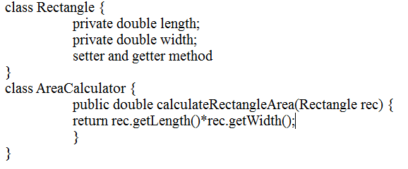

Slide 17
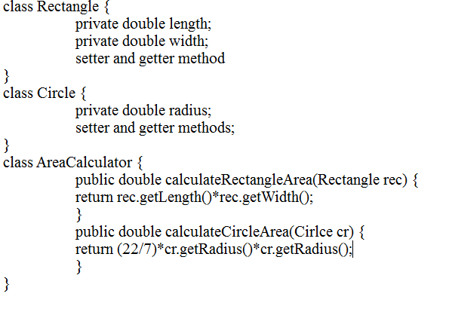

Slide 18
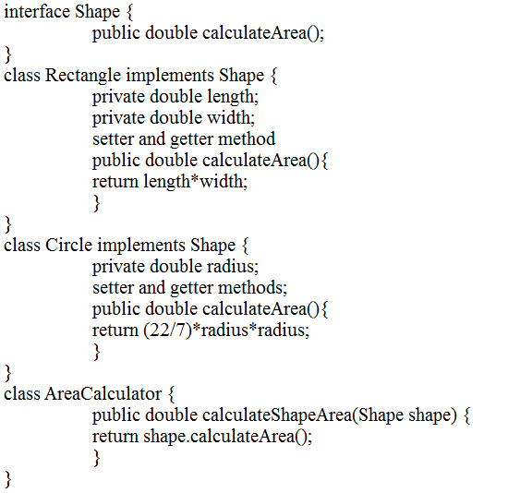

Slide 19
Liskov Substitution Principle
“objects in a program should be replaceable with instances of their subtypes without altering the correctness of that program”
This is actually in line with what Java also allows. A super class reference can hold a subclass object i.e. super class can be replaced by subclass in a super class reference at any time. So, Java inheritance mechanism follows Liskov Substitution Principle.

Slide 20
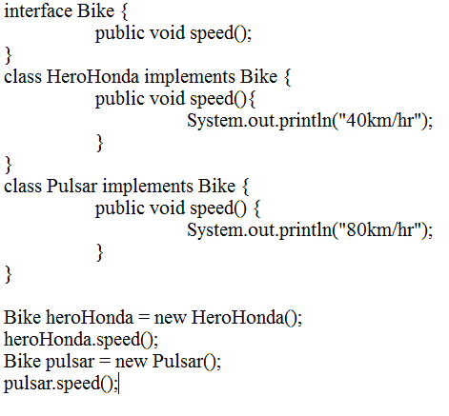

Slide 21
Interface Segregation Principle
“Many client specific interfaces are better than one general purpose interface”
Instead of having a single interface catering to all the clients, i.e. holding all the methods for all the clients, it is better to have multiple interfaces with each interface containing methods for a client-specific functionality or to have functionally cohesive interfaces.

Slide 22
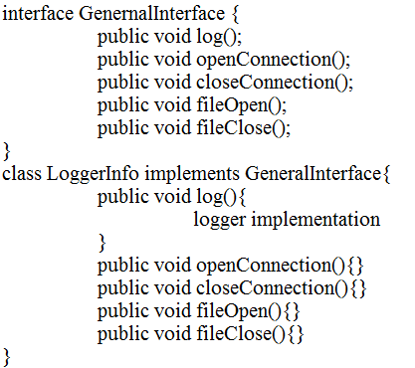
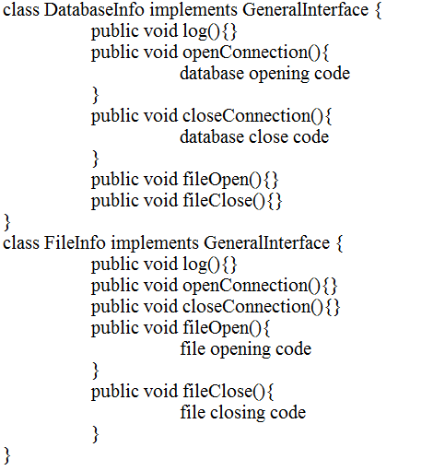

Slide 23
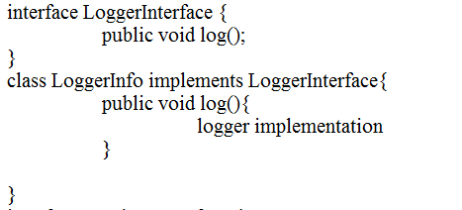
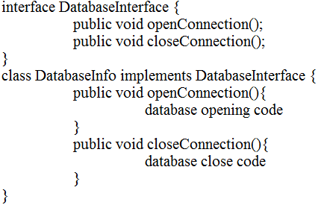
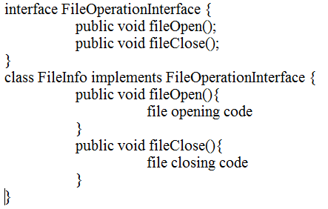

Slide 24
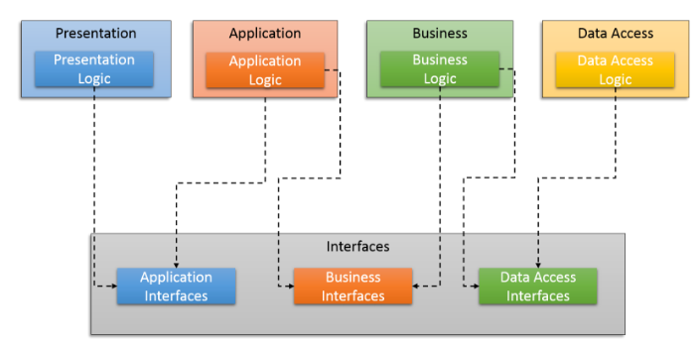
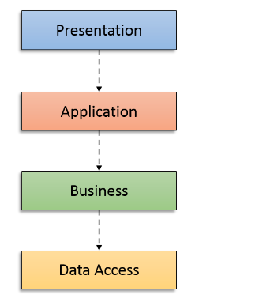
Dependency Inversion principle
“Abstractions should not depend upon details. Details should depend upon abstractions”
Or
“High-level modules should not depend on low-level modules. Both should depend on abstractions.”

Slide 25
Java Core Design Patterns

Slide 26
Core Design pattern
Here’s an overview of some core design patterns, often categorized into Creational, Structural, and Behavioral patterns, based on the type of problem they solve:
CREATIONAL PATTERNS
Deals with Initializing and Configuring Classes and Objects.
STRUCTURAL PATTERNS
Deals with Decoupling interface and Implementation of classes and objects.
BEHAVIORAL PATTERNS
Deals with Dynamic interactions among classes and objects.

Slide 27
Creational Design Patterns
Focus on object creation mechanisms, ensuring flexibility and reuse.
Singleton
Factory method
Abstract factory
Builder
Prototype

Slide 28
Structural Design Patterns
Deal with object composition, making it easier to manage relationships between objects.
Adapter
Bridge
Composite
Decorator
Façade
Flyweight
Proxy

Slide 29
Behavioral design pattern
Focus on object interaction and responsibility distribution.
Chain of responsibility
Command
Interceptor
Iterator
Mediator
Memento
Observer
State
Visitor
Template

Slide 30
Creational design pattern

Slide 31
Singleton design pattern
Singleton:
Purpose: Ensures a class has only one instance and provides a global access point to it.
Problem & Context
Sometimes there may be a need to have one and only one instance of a given class during the lifetime of an application. This may be due to necessity or, more often, because only a single instance of the class is sufficient
Solution
Create a class with a method that creates a new instance of the object if one does not exist. If one does exist, it returns a reference to the object that already exists. To make sure that the object cannot be instantiated any other way, the constructor is made either private or protected
Use Case: Database connections, logging classes, or configurations

Slide 32
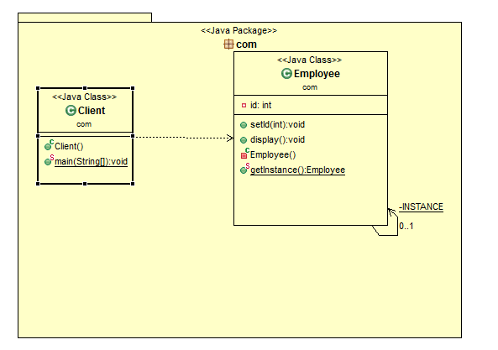

Slide 33
Factory Method
Factory Method:
Purpose: Defines an interface for creating objects but lets subclasses alter the type of created object.
Problem & Context
If an object needs to know the selection criteria to instantiate an appropriate class, this results in a high degree of coupling. Whenever the selection criteria change, every object that uses the class must be changed correspondingly
Solution
Encapsulate the functionality required to select and instantiate the appropriate class. One way to do this is to create an abstract class or an interface that declares the factory method. Different subclasses can then implement the method in its entirety

Slide 34
Factory Method
Use Case: When a class can’t anticipate which class of objects it needs to create.
Example:
Factory Method Pattern can be seen in vehicle manufacturing, where different types of vehicles (e.g., cars, motorcycles, and trucks) need to be created dynamically based on customer requests.
Factory Method Pattern can be seen in payment processing systems, where different payment methods (e.g., credit card, PayPal, bank transfer) are handled depending on user preferences.

Slide 35
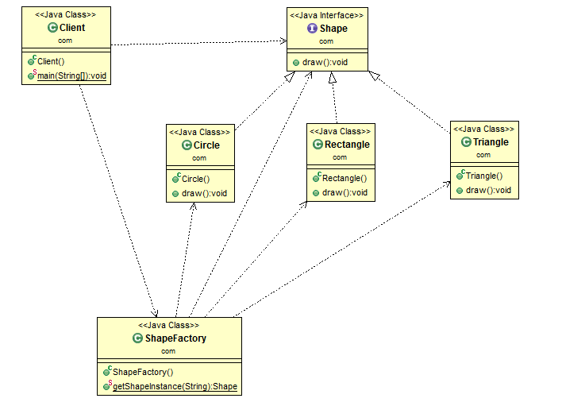

Slide 36
Pros and cons of abstract factory
Pros
Abstraction, Polymorphism, Loosely coupling
Shields clients from concrete classes
if a framework uses the Factory Method pattern, it enables third-party developers to plug-in new Shape.
Cons
Too much abstracts.
Inheritance based
One for the concrete Shape and one for the concrete Color ie hierarchy dependent

Slide 37
Abstract Factory
Abstract Factory:
Purpose: Provides an interface to create families of related or dependent objects without specifying their concrete classes.
Problem & Context
Useful when an object wants to create an instance of a suite of related and dependent classes without having to know which specific concrete class is instantiated. In its absence, the required implementation needs to be present wherever such an instance is created
Solution
Provide the necessary interface for creating instances. Different concrete factories implement this interface. In Java, it is an abstract class with its concrete subclasses as factories. Each factory is responsible for creating and providing access to the objects

Slide 38
Abstract Factory
Abstract Factory:
Use Case: GUI applications that need to support multiple themes or look-and-feel settings.
Example :
A vehicle manufacturer that produces different types of vehicles (e.g., Cars, Bikes) for different markets (e.g., Electric, Gasoline). Each factory would produce a specific type of vehicle according to the specifications of the market.

Slide 39
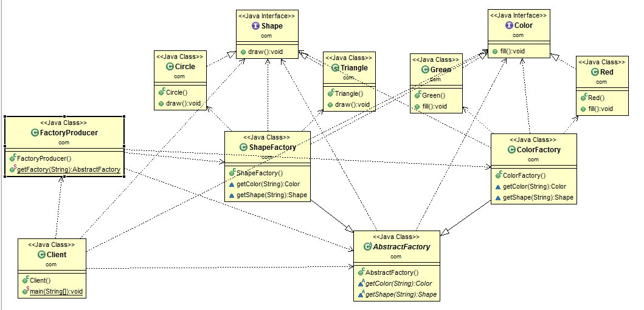

Slide 40
Pros and cons of abstract factory
Pros
Shields clients from concrete classes.
Easy to switch product family at runtime Just change concrete factory
Keep it in the family
Cons
Adding a new product means changing factory interface + all concrete factories

Slide 41
Builder:
Builder:
Purpose: Separates the construction of a complex object from its representation, allowing the same process to create different representations.
Problem & Context
Object construction details are kept within the object as part of its constructor. This may not be effective when the object being created is complex and the object creation process produces different representations of the object. The object can become bulky (construction bloat) and less modular
Solution
Move the construction logic out of the object class to separate classes referred to as builder classes. A dedicated object referred to as a Director, is responsible for invoking different builder methods required for the construction of the final object. Different client objects can make use of the Director object to create the required object

Slide 42
Builder:
Builder:
Use Case: Complex object construction with many optional parts, like creating a meal in a fast-food ordering system.
Example
In Java, StringBuilder, internally use Builder design pattern.
ResponseEntity class part of spring framework internally follow builder design pattern.

Slide 43
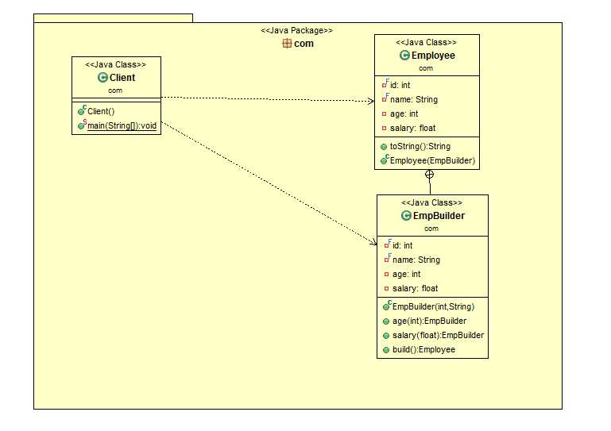

Slide 44
Real time example in API
@GetMapping
public Response passIdResponse(@PathVariable("id") int id) {
System.out.println("The employee id is "+id);
String output="The employee id is "+id;
return Response.status(200).entity(output).build();
Or
return Response.status(200).build();
Or
return Response.status(200).cookie(CookiesRef).entity(output).build();
}

Slide 45
Pros and cons of abstract factory
Pros
The client code is easier to write and, more importantly, to read.
The fact that the builder class is usually a static member class of the class it builds, they can evolve together fairly easy.
Cons
The fact that you have to duplicate the class's attributes on the builder.

Slide 46
Prototype:
Prototype:
Purpose: Creates new objects by cloning an existing object (prototype).
Problem & Context
When clients need to create a set of objects that are cost prohibitive and alike or differ only in terms of their state, create one object upfront and designate it as a prototype object or simply make a copy of the prototype object
Solution
Provide a way for clients to create a copy of the prototype object. By default, all Java objects inherit the built in clone() method that creates a clone of the original object

Slide 47
Prototype:
Prototype:
Use Case: When object creation is costly (like in games) and instances share most properties.
Example
Graphic Editing software : Allow users to duplicate existing shapes with different attributes.
Document management system : clone a configuration prototype to create a new configuration for different environment without starting from scratch.

Slide 48
Copy object
Types of copy
Shallow copy: Generally clone method of an object, creates a new instance of the same class and copies all the fields to the new instance and returns it. This is nothing but shallow copy.
Deep copy : When the copied object contains some other object its references are copied recursively in deep copy. When you implement deep copy be careful as you might fall for cyclic dependencies. If you don’t want to implement deep copy yourselves then you can go for serialization.

Slide 49
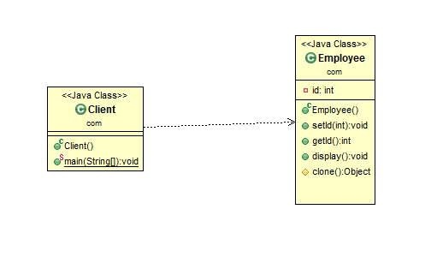

Slide 50
Pros and cons of abstract factory
Pros
Don’t need to call a constructor explicitly or when a system don’t need to depend on way of objects creation.
Hides the complexities of making new instances from the client.
Cons
Classes that have circular references can be difficult to deep clone.

Slide 51
Structural Design Patterns

Slide 52
Adapter:
Adapter:
Purpose: Converts the interface of a class into another interface that clients expect, allowing classes with incompatible interfaces to work together.
Problem & Context
Sometimes an existing class may provide the functionality required by a client, but its interface may not be what the client expects. In such cases, the existing interface needs to be converted into an interface that the client expects, preserving the reusability of the existing class
Solution
Define a wrapper class around the object with the incompatible interface. The adapter provides the required interface expected by the client. The implementation of the adapter interface converts client requests into calls to the adoptee class interface

Slide 53
Adapter:
Adapter:
Use Case: Integrating legacy code with modern applications
Example
Integrating Legacy Systems: The adapter acts as a bridge, allowing new systems to communicate with older systems that have incompatible interfaces, thereby facilitating integration without extensive rewrites.
Third-Party Library Integration: An adapter can wrap the third-party API to match the application's existing interface, making it easier to integrate and reducing the learning curve for developers.
Few pre defined API internally use Adapter design pattern
WindowAdapter :
KeyAdapter :
MouseAdapter :
InputStreamReader and BufferedReader

Slide 54
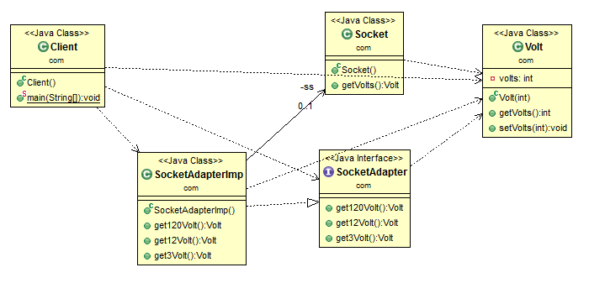

Slide 55
Pros and cons of abstract factory
Pros
It allows more flexibility in design.
They handle logic by wrapping a new interface around that of an existing class so you can use new APIs (with different interfaces) and avoid breaking existing implementations.
Cons
It unnecessarily increases the size of the code as class inheritance is less used and lot of code is needlessly duplicated between classes.
Sometimes many adaptations are required along an adapter chain to reach the type which is required.

Slide 56
Bridge:
Bridge:
Purpose: Decouples an abstraction from its implementation, allowing both to vary independently.
Problem & Context
An abstraction can be designed as an interface with one or more concrete implementers. When sub classing the hierarchy, it could lead to an exponential number of subclasses. And since both the interface and its implementation are closely tied together, they cannot be independently varied without affecting each other
Solution
Put both the interfaces and the implementations into separate class hierarchies. The Abstraction maintains an object reference of the Implementer type. A client application can choose a desired abstraction type from the Abstraction class hierarchy. The abstraction object can then be configured with an instance of an appropriate implementer from the Implementer class hierarchy

Slide 57
Bridge:
Bridge:
Use Case: Separating UI components from the platform-specific operations.
Example
UI Frameworks: The Bridge Pattern allows a UI framework to be independent of the underlying UI toolkit (like Swing, JavaFX, or HTML/CSS), enabling a consistent interface across different platforms.
Payment Gateway Integration: The Bridge Pattern can help in designing a payment processing system where the payment interface is separated from the implementation, making it easy to add or change payment methods without altering the core logic.
Pre defined API internally use Bridge pattern
JDBC API ie Connection, Statetement, ResultSet etc
RMI API
SOA Architecture

Slide 58
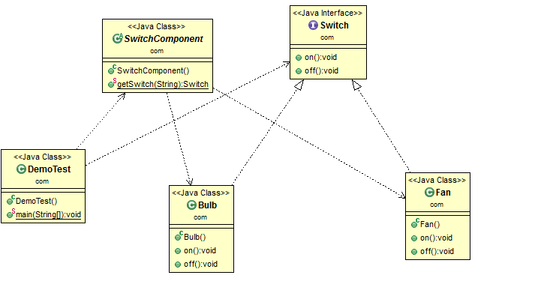

Slide 59
Composite:
Composite:
Purpose: Composes objects into tree structures to represent part-whole hierarchies, allowing clients to treat individual and composite objects uniformly.
Problem & Context
Useful in designing a common interface for both individual and composite components so that client programs can view both the individual components and groups of components uniformly
Solution
Simulate a file system that consists of directories, files and an interface called FileSystem with methods (such as getSize(), getComponent(), addComponent()) common for both File and Directory components. File and Directory classes are the implementers of the interface. A typical client would create a set of FileSystem objects including a hierarchy of file system objects. The client can treat both the Directory and File objects identically

Slide 60
Composite:
Composite:
Use Case: GUI applications where components (buttons, panels) can contain other components.
Example
A Panel class can contain multiple Button, Label, and Textbox instances. Each of these can be treated uniformly, allowing you to manipulate the entire UI hierarchy as a single object.
Example: A Directory can contain both File and other Directory objects. Operations like getSize() can be implemented at both levels, allowing clients to call this method on any file system entity.
Reading XML data from a XML file ie read a tag check it, it is complex or simple. If it is a complex then read its child tag other wise read its data. Continue this process till get the simple tags.

Slide 61
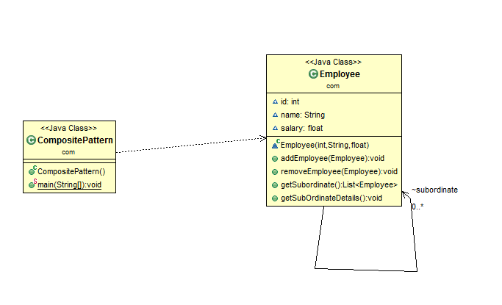
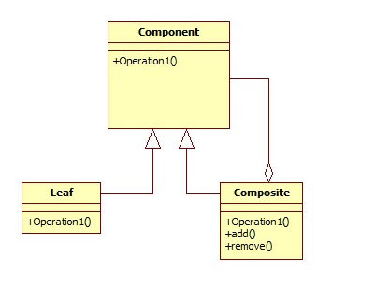

Slide 62
Pros and cons of abstract factory
Pros
It makes it easy to add new kids of components
It makes client simpler
Cons
It makes it harder to restrict the type of component of a composite.

Slide 63
Decorator:
Decorator:
Purpose: Adds additional responsibilities to an object dynamically, without altering its structure.
Problem & Context
This pattern allows new/additional behavior to be added to an existing method of an object dynamically. Since classes cannot be created at runtime and it is typically not possible to predict what extensions will be needed at design time, a new class would have to be made for every possible combination. By contrast, decorators are objects, created at runtime, and can be combined on a per-use basis
Solution
Pass the original object as a parameter to the constructor of the decorator, with the decorator implementing the new functionality. The interface of the original object needs to be maintained by the decorator

Slide 64
Decorator:
Decorator:
Use Case: Adding features (like scroll bars, borders) to UI components.
Example
In Java, you can use classes like BufferedReader or DataInputStream to decorate a basic InputStream. This allows you to read data in a more efficient or convenient way without modifying the original InputStream class.
The decorator must be of the same type of object, which they are decorating. This can be achieved either by implementing the interface of the object or by extending an abstract class of the original class.

Slide 65
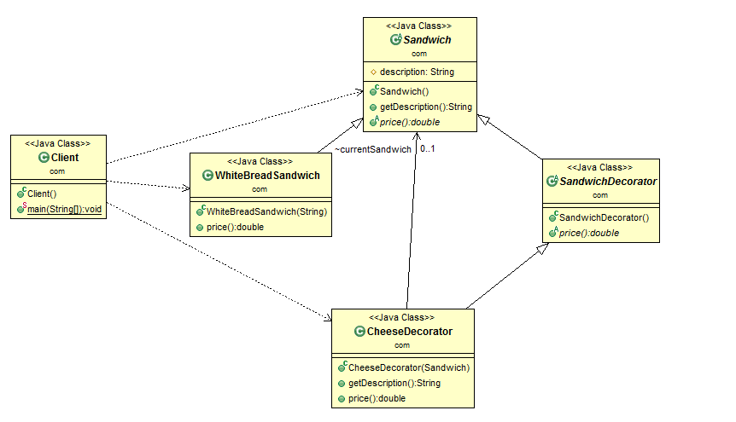

Slide 66
Facade:
Facade:
Purpose: Provides a simplified interface to a complex subsystem.
Problem & Context
The Façade object takes up the responsibility of interacting with the subsystem classes. In effect, clients interface with the façade to deal with the subsystem. Consequently, the Façade pattern promotes a weak coupling between a subsystem and its clients
Solution
A façade should not be designed to provide any additional functionality. Never return subsystem components from Façade methods to clients

Slide 67
Facade:
Facade:
Use Case: Simplifying complex libraries or APIs (like accessing multiple methods in a database library) like JDBC
Example
A PaymentFacade can encapsulate the complexities of different payment gateways (like PayPal, Stripe, etc.), providing a unified interface for processing payments without exposing the details of each service.

Slide 68
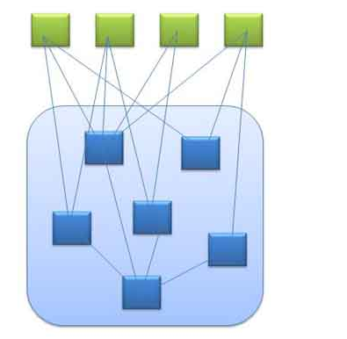
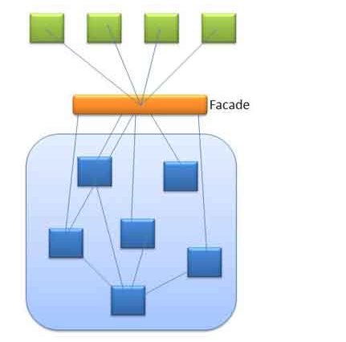

Slide 69
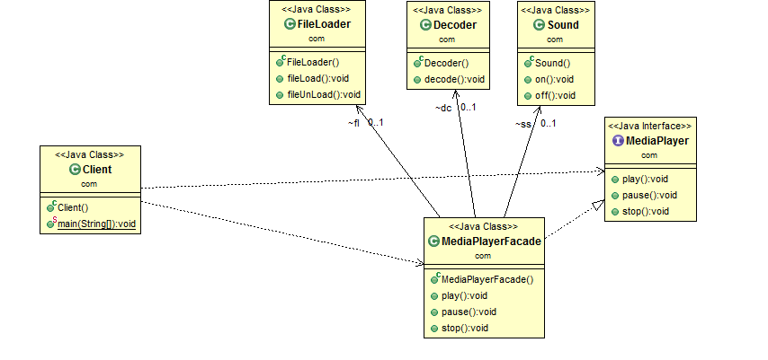

Slide 70
Uses of Façade Pattern
It shields the clients from the complexities of the sub-system components.
It promotes loose coupling between subsystems and its clients.
When you want to provide simple interface to a complex sub-system.
When several dependencies exist between clients and the implementation classes of an abstraction.
Putting all methods in a facade is not a good approach. You should think about splitting into several facades and group the methods based on their functionality.

Slide 71
Flyweight:
Flyweight:
Purpose: Minimizes memory use by sharing as much data as possible with similar objects.
Problem & Context
This pattern suggests separating all the intrinsic common data into a separate object referred to as a Flyweight object. The group of objects being created can share the Flyweight object as it represents their intrinsic state. This eliminates the need for storing the same invariant, intrinsic information in every object; instead it is stored only once in the form of a single Flyweight object
Solution
Design flyweight as a singleton with a private constructor. The client creates an object with the exclusive extrinsic data or sends the extrinsic data as part of a method call to the Flyweight object. This results in the creation of few objects with no duplication

Slide 72
Flyweight:
Intrinsic states are things that are constant and are stored in the memory.
Example Shape width and height and position.
Extrinsic states are things that are not constant and need to be calculated on the fly, and are therefore not stored in the memory.
Shape color, thickness

Slide 73
Flyweight:
Use Case: Applications with a large number of similar objects, like game characters or text processing.
Example
A Connection Pool can manage shared database connection instances, where each connection can be a flyweight object, reducing the overhead of creating new connections for each request.

Slide 74
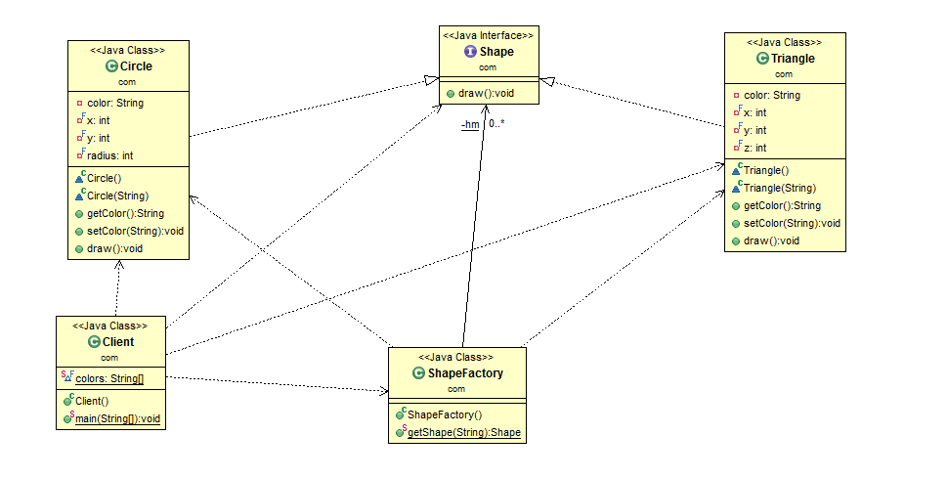

Slide 75
Proxy:
Proxy:
Purpose: Provides a surrogate or placeholder for another object to control access to it.
Problem & Context
A client object can directly access a service provider object but sometimes a client object may not have access to a target object by normal means. The reasons could be: location, state of existence, and special behavior of target object. Instead of having client objects to deal with the special requirements for accessing the target object, the Proxy pattern suggests using a separate object referred to as a proxy to provide a means for different client objects to access the target object in a normal, straightforward manner
Solution
A proxy object should represent a single object. It provides access control to the single target object, and offers the same interface

Slide 76
Proxy:
Proxy:
Use Case: Access control, lazy initialization, or logging.
Example
A ImageProxy can be used to load an image only when it is required, improving performance by deferring resource loading until absolutely necessary.
Proxy Server

Slide 77
Proxy:
Cache Proxy. A cache proxy improves the performance of the underlying object's members when they perform long-running tasks that return seldom-changing results.
Protection Proxy. A protection proxy adds a layer of security to the underlying subject object.
Remote Proxy. A remote proxy provides a local object that references a subject object in another location, generally via a network connection.
Smart Proxy. Smart proxies add extra functionality to the calls to the real object's members. This functionality is often invisible to the client object.

Slide 78
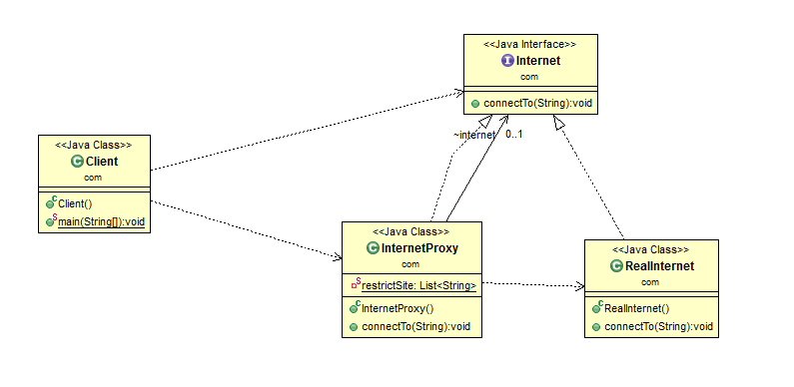

Slide 79
Pros and cons of abstract factory
Pros
We don't need to update the existing top level class with any flag to check if this feature is enabled, and to conditionally execute code.
Single point of control
Cons
There are ways of more tightly binding between proxy and legacy.
Unnecessarily complicated

Slide 80
Behavioral design pattern

Slide 81
Chain of Responsibility:
Chain of Responsibility:
Purpose: Passes a request along a chain of handlers until an object handles it.
Problem & Context
When there is more than one object that can handle or fulfill a client request, each of these potential handler objects can be arranged in the form of a chain, with each object having a pointer to the next object in the chain
Solution
The order in which the objects form the chain can be decided dynamically at runtime by the client. All potential handler objects should provide a consistent interface. Neither the client object nor any of the handler objects in the chain need to know which object will actually fulfill the request

Slide 82
Chain of Responsibility:
Chain of Responsibility:
Use Case: Handling events or requests in sequential processing like in logging systems.
Example
A logging framework can have a chain of log handlers that directs log messages to appropriate outputs (like console, file, or remote server) based on their severity.
A customer support system can use a chain of support representatives (e.g., first line support, technical support, manager) where each representative decides whether to handle the inquiry or escalate it to the next representative.

Slide 83
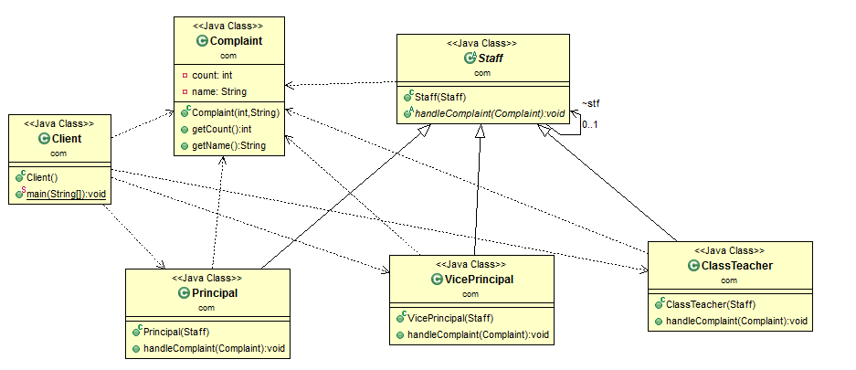

Slide 84
Command:
Command:
Purpose: Encapsulates a request as an object, allowing for parameterization of requests and queuing.
Problem & Context
Used when there is a proliferation of similar methods and the interface to implement an object becomes unwieldy – too many public methods for other objects to call, an interface that is unworkable and always changing
Solution
Create an abstraction for the processing in response to client requests by declaring a common interface to be implemented by different concrete implementers referred to as Command objects. A given Command object does not contain the actual implementation of the functionality. Command objects make use of Receiver objects in offering this functionality

Slide 85
Command:
Command:
Use Case: Implementing undo/redo operations in text editors.
Example
Each scheduled job can be encapsulated in a command object that defines the task to be executed. The scheduler can queue, cancel, or execute jobs without needing to know the details of each task.

Slide 86
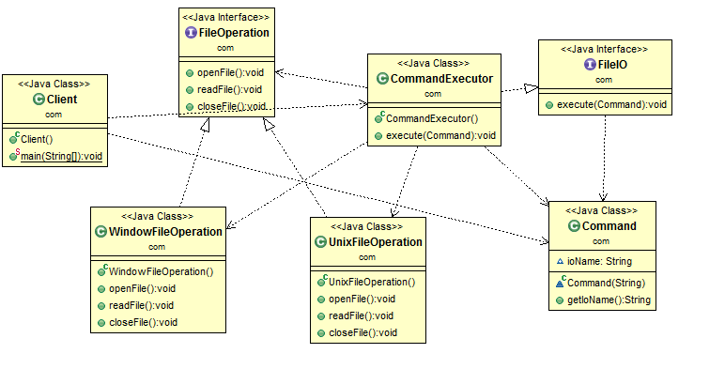

Slide 87
Interpreter:
Interpreter:
Purpose: Defines a grammatical representation for a language and provides an interpreter to interpret sentences.
Use Case: Compilers or data parsers.
Example
java command

Slide 88
Iterator:
Iterator:
Purpose: Provides a way to access elements of a collection without exposing the underlying representation.
Use Case: Iterating over collections like lists or trees.
Example
Foreach
Iterator
ListIterator
Enumeration

Slide 89
Mediator:
Mediator:
Purpose: Reduces direct communication between objects by introducing a mediator object.
Problem & Context
Objects interact with each other for the purpose of providing a service. This interaction can be direct (point-to-point). As the number of objects increases, the interaction can lead to a complex maze of references among objects. Having an object directly referring to other objects greatly reduces the scope for reuse
Solution
The Mediator pattern suggests abstracting all object interaction details into a separate class, referred to as a Mediator. The interaction between any two different objects is routed through the Mediator class. All objects send their messages to the mediator

Slide 90
Mediator:
Mediator:
Use Case: UI component interactions where each element does not need to know about the others.
Example
An air traffic control mediator can coordinate communication between pilots and controllers, handling requests for landing, takeoff, and flight paths without direct communication between planes.

Slide 91
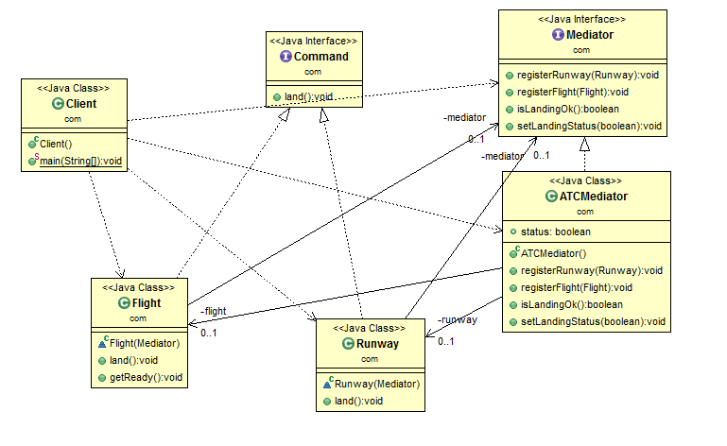

Slide 92
Memento:
Memento:
Purpose: Saves and restores an object's state without exposing its internal structure.
Problem & Context
The state of an object can be defined as the values of its attributes at any given point of time. The Memento pattern is useful for designing a mechanism to capture and store the state of an object so that, when needed, the object can revert to its previous state. This is more like an undo operation
Solution
The object whose state needs to be captured is referred to as the originator. The originator stores its attributes in a separate object referred to as a Memento. A Memento object must hide the originator variable values from all objects except the originator. A Memento should be designed to provide restricted access to other objects while the originator is allowed to access its internal state

Slide 93
Memento:
Memento:
Use Case: Undo and rollback functionalities.
Example
The editor can save the state of a document at various points. When the user requests an undo action, the editor can revert to the previously saved state using mementos.

Slide 94
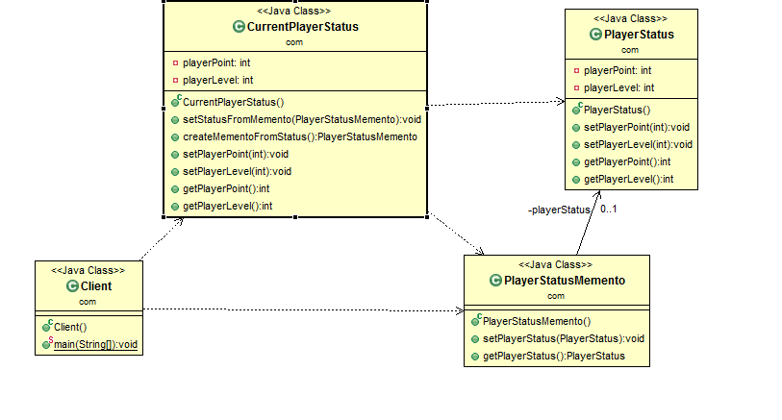

Slide 95
Observer:
Observer:
Purpose: Defines a one-to-many dependency where multiple observers are notified of state changes in a subject.
Problem & Context
Useful for designing a consistent communication model between a set of dependent objects (observers) and an object that they are dependent on (subject). This allows the observers to have their state synchronized with the subject. Each of these observers needs to know when the subject undergoes a change in its state
Solution
The subject should provide an interface for registering and unregistering change notifications. Observers should provide an interface for receiving notifications from the subject

Slide 96
Observer:
Observer:
Use Case: Event handling systems, like GUI where buttons notify listeners.
Example
Stock market applications where multiple clients need to be notified of changes in stock prices. When a stock's price changes, the application can notify all registered observers (e.g., charts, alerts) to update their displays accordingly.

Slide 97
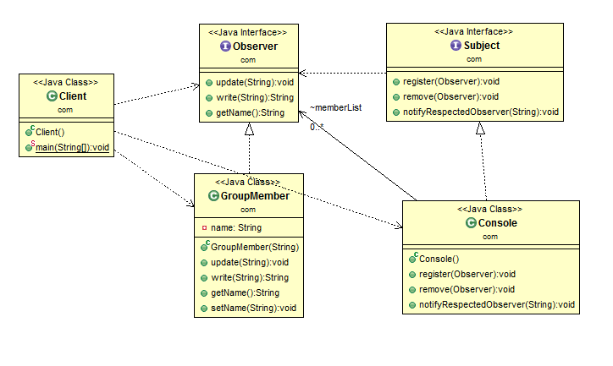

Slide 98
State:
State:
Purpose: Allows an object to alter its behavior when its internal state changes.
Problem & Context
Useful in designing an efficient structure for a class, a typical instance of which can exist in many different states and exhibit different behavior depending on its state. In the case of an object of such a class, some or all of its behavior is completely influenced by its current state. Such a class is referred to as a Context class. A Context object can alter its behavior when there is a change in its internal state and is also referred as a Stateful object
Solution
The State pattern suggests moving the state-specific behavior out of the Context class into a set of separate classes referred to as State classes. Each of the many different states in which a Context object can exist can be mapped into a separate State class

Slide 99
State:
State:
Use Case: State-based behavior, such as a TCP connection changing states between Open, Closed, etc.
Example
An order can be in various states (e.g., new, processing, shipped, delivered, canceled). The behavior of the order processing system can change depending on the current state, allowing for appropriate actions to be taken at each stage.

Slide 100
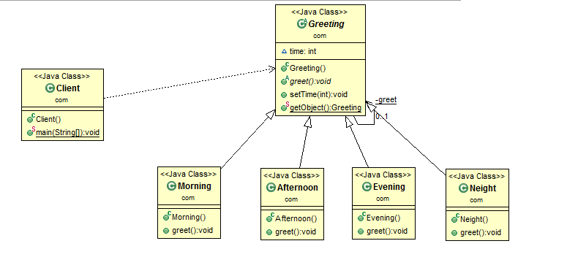

Slide 101
Strategy:
Strategy:
Purpose: Defines a family of algorithms, encapsulates each, and makes them interchangeable.
Problem & Context
Useful when there is a set of related algorithms and a client object needs to be able to dynamically pick and choose an algorithm that suits its current need. The implementation of each of the algorithms is kept in a separate class referred to as a strategy. An object that uses a Strategy object is referred to as a context object. Changing the behavior of a Context object is a matter of changing its Strategy object to the one that implements the required algorithm
Solution
All Strategy objects must be designed to offer the same interface. In Java, this can be accomplished by designing each Strategy object either as an implementer of a common interface or as a subclass of a common abstract class that declares the required common interface

Slide 102
Strategy:
Strategy:
Use Case: Payment processing methods that can be changed at runtime.
Example
A sorting application can implement various sorting algorithms (e.g., QuickSort, MergeSort, BubbleSort). The client can choose which sorting strategy to use at runtime based on user preferences or data characteristics.
An online store can have different payment strategies (e.g., credit card, Paytm, Phone Pay, Google Pay ). The application can switch between these payment methods dynamically based on user selection without modifying the core payment processing code.

Slide 103
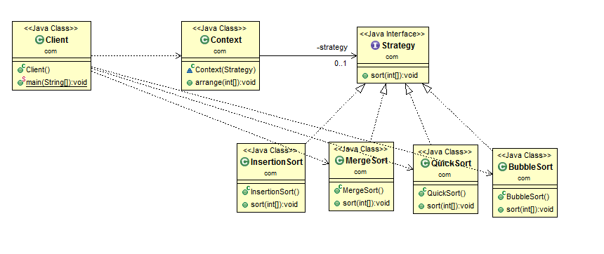

Slide 104
Template Method:
Template Method:
Purpose: Defines the skeleton of an algorithm, allowing subclasses to redefine certain steps without altering the structure.
Problem & Context
Used in situations when there is an algorithm, some steps of which could be implemented in many different ways. The outline of the algorithm is kept in a separate method referred to as a template method inside a class, referred to as a template class, leaving out the specific implementations of the variant portions of the algorithm to different subclasses of this class
Solution
The Template method can be a concrete, non abstract method with calls to other methods that represent different steps of the algorithm. Specific implementations can be provided for these abstract methods inside a set of concrete subclasses of the abstract Template class

Slide 105
Template Method:
Template Method:
Use Case: Algorithms with a fixed structure but customizable steps.
Example
A data export system can define a base export class with methods for setting up the export process. Subclasses can implement specific export behaviors for formats like CSV, XML, and JSON while maintaining the core export logic.

Slide 106
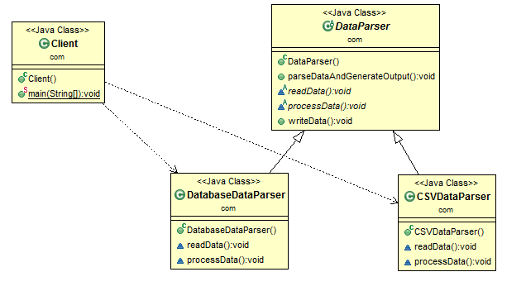

Slide 107
Template Method:
Template method in super class follows “the Hollywood principle”: “Don't call us, we'll call you”.
This refers to the fact that instead of calling the methods from base class in the subclasses, the methods from subclass are called in the template method from super class.
Template method in super class should not be overridden so make it final
Template methods are technique for code reuse because with this , you can figure out common behaviour and defer specific behaviour to subclasses.

Slide 108
Visitor:
Visitor:
Purpose: Allows adding new virtual functions to a class hierarchy without modifying the classes.
Problem & Context
Visitor is useful in a heterogeneous collection of objects of a class hierarchy. It allows operations to be defined without changing the class of any of the objects in the collection. The Visitor pattern suggests defining the operation in a separate class referred to as a visitor class, which separates the operation from the object collection on which it operates. For every new operation to be defined, a new visitor class is created
Solution
Every visitor class that operates on objects of the same set of classes can be designed to implement a corresponding Visitor interface. A typical Visitor interface declares a set of visit(ObjectType) methods, one for each object type from the object collection. Each of these methods is meant for processing instances of a specific class

Slide 109
Visitor:
Visitor:
Use Case: Operations on a complex object structure, like file system structures.
Example
In a collection of different data types (e.g., trees, graphs), a visitor can be used to perform operations like traversal, searching, or aggregating data without changing the data structure classes.

Slide 110
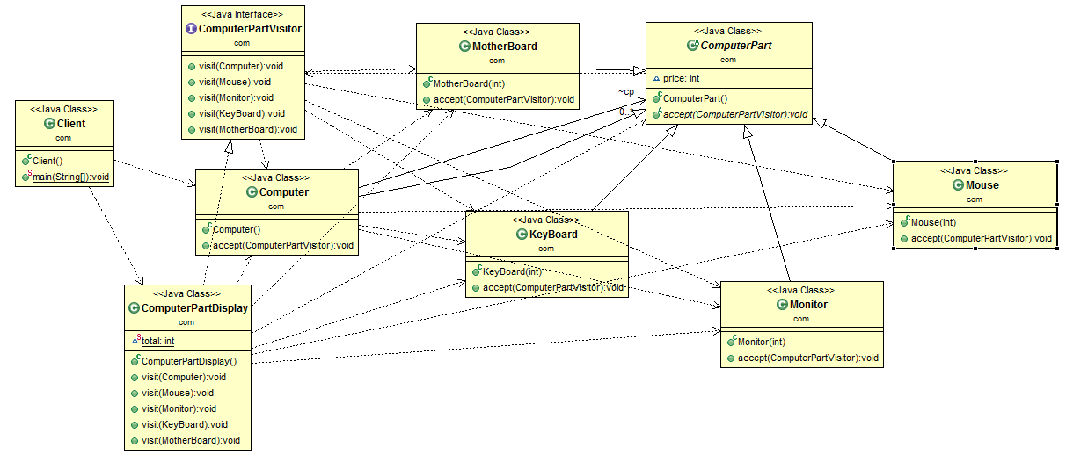

Slide 111
Java EE (JEE) Design Patterns

Slide 112
Front controller :
The Front Controller pattern is a structural pattern commonly used in web applications to centralize request handling through a single controller. Instead of having multiple controllers handling requests directly, a front controller intercepts all requests and delegates them to the appropriate handlers.
Purpose:
To centralize and streamline request handling.
To apply common processing (e.g., authentication, logging, and security) for all incoming requests in a single place.
Use Case :
In web applications where you want a single entry point for all requests.
When there’s a need to enforce consistent behavior for all requests (e.g., user authentication, input sanitization).
Notes:
Front Controller Pattern Overview
Purpose:
To centralize and streamline request handling.
To apply common processing (e.g., authentication, logging, and security) for all incoming requests in a single place.
Use Case:
In web applications where you want a single entry point for all requests.
When there’s a need to enforce consistent behavior for all requests (e.g., user authentication, input sanitization).
How It Works
Single Entry Point: The front controller acts as the single entry point for all incoming requests. It receives and processes all requests.
Request Delegation: Based on the request, the front controller delegates the request to the appropriate handler or controller within the application.
Pre-Processing and Post-Processing: The front controller can handle common pre-processing (e.g., authentication checks) and post-processing (e.g., logging responses) tasks.
Components of the Front Controller Pattern
Front Controller: The main controller that processes all incoming requests.
Dispatcher: Responsible for directing the requests from the front controller to specific request handlers or views.
View: Represents the response that the application sends back to the user.
Helper Classes: Contains utility methods that support the front controller’s functions, like input validation or authorization checks.
Advantages of Using the Front Controller Pattern
Centralized Control: It provides a single entry point for all requests, enabling consistent pre-processing for all incoming requests.
Improved Security: Since all requests go through one entry point, it’s easier to implement and enforce security measures.
Simplified Maintenance: With a single location for request handling, updates to request processing logic are easier to manage.
Reusability: Common logic (e.g., logging, security checks) is centralized, reducing code duplication.
Example of the Front Controller Pattern
A common implementation of the front controller pattern is in web frameworks, where there is typically one main controller (like a DispatcherServlet in Spring MVC) that routes incoming HTTP requests to appropriate controllers based on URL patterns or other routing rules.

Slide 113
Model View and Controller :
The Model-View-Controller (MVC) pattern is one of the most widely used architectural patterns in software development, especially in web applications. It helps separate an application into three main interconnected components, each responsible for handling specific aspects of the application. This separation improves code organization, maintainability, and testability.
Notes:
Front Controller Pattern Overview
Purpose:
To centralize and streamline request handling.
To apply common processing (e.g., authentication, logging, and security) for all incoming requests in a single place.
Use Case:
In web applications where you want a single entry point for all requests.
When there’s a need to enforce consistent behavior for all requests (e.g., user authentication, input sanitization).
How It Works
Single Entry Point: The front controller acts as the single entry point for all incoming requests. It receives and processes all requests.
Request Delegation: Based on the request, the front controller delegates the request to the appropriate handler or controller within the application.
Pre-Processing and Post-Processing: The front controller can handle common pre-processing (e.g., authentication checks) and post-processing (e.g., logging responses) tasks.
Components of the Front Controller Pattern
Front Controller: The main controller that processes all incoming requests.
Dispatcher: Responsible for directing the requests from the front controller to specific request handlers or views.
View: Represents the response that the application sends back to the user.
Helper Classes: Contains utility methods that support the front controller’s functions, like input validation or authorization checks.
Advantages of Using the Front Controller Pattern
Centralized Control: It provides a single entry point for all requests, enabling consistent pre-processing for all incoming requests.
Improved Security: Since all requests go through one entry point, it’s easier to implement and enforce security measures.
Simplified Maintenance: With a single location for request handling, updates to request processing logic are easier to manage.
Reusability: Common logic (e.g., logging, security checks) is centralized, reducing code duplication.
Example of the Front Controller Pattern
A common implementation of the front controller pattern is in web frameworks, where there is typically one main controller (like a DispatcherServlet in Spring MVC) that routes incoming HTTP requests to appropriate controllers based on URL patterns or other routing rules.

Slide 114
MVC - Model :
Model
Purpose: Represents the data and business logic of the application.
Responsibilities:
Encapsulates the application's core data and rules.
Manages data and applies business logic.
Often interacts with a database to store and retrieve information.
Notes:
Front Controller Pattern Overview
Purpose:
To centralize and streamline request handling.
To apply common processing (e.g., authentication, logging, and security) for all incoming requests in a single place.
Use Case:
In web applications where you want a single entry point for all requests.
When there’s a need to enforce consistent behavior for all requests (e.g., user authentication, input sanitization).
How It Works
Single Entry Point: The front controller acts as the single entry point for all incoming requests. It receives and processes all requests.
Request Delegation: Based on the request, the front controller delegates the request to the appropriate handler or controller within the application.
Pre-Processing and Post-Processing: The front controller can handle common pre-processing (e.g., authentication checks) and post-processing (e.g., logging responses) tasks.
Components of the Front Controller Pattern
Front Controller: The main controller that processes all incoming requests.
Dispatcher: Responsible for directing the requests from the front controller to specific request handlers or views.
View: Represents the response that the application sends back to the user.
Helper Classes: Contains utility methods that support the front controller’s functions, like input validation or authorization checks.
Advantages of Using the Front Controller Pattern
Centralized Control: It provides a single entry point for all requests, enabling consistent pre-processing for all incoming requests.
Improved Security: Since all requests go through one entry point, it’s easier to implement and enforce security measures.
Simplified Maintenance: With a single location for request handling, updates to request processing logic are easier to manage.
Reusability: Common logic (e.g., logging, security checks) is centralized, reducing code duplication.
Example of the Front Controller Pattern
A common implementation of the front controller pattern is in web frameworks, where there is typically one main controller (like a DispatcherServlet in Spring MVC) that routes incoming HTTP requests to appropriate controllers based on URL patterns or other routing rules.

Slide 115
MVC - View :
View
Purpose: Represents the presentation layer, responsible for displaying data to the user.
Responsibilities:
Displays the data provided by the Model.
Provides the user interface (UI) elements.
Reflects any changes made to the Model (data).
Notes:
Front Controller Pattern Overview
Purpose:
To centralize and streamline request handling.
To apply common processing (e.g., authentication, logging, and security) for all incoming requests in a single place.
Use Case:
In web applications where you want a single entry point for all requests.
When there’s a need to enforce consistent behavior for all requests (e.g., user authentication, input sanitization).
How It Works
Single Entry Point: The front controller acts as the single entry point for all incoming requests. It receives and processes all requests.
Request Delegation: Based on the request, the front controller delegates the request to the appropriate handler or controller within the application.
Pre-Processing and Post-Processing: The front controller can handle common pre-processing (e.g., authentication checks) and post-processing (e.g., logging responses) tasks.
Components of the Front Controller Pattern
Front Controller: The main controller that processes all incoming requests.
Dispatcher: Responsible for directing the requests from the front controller to specific request handlers or views.
View: Represents the response that the application sends back to the user.
Helper Classes: Contains utility methods that support the front controller’s functions, like input validation or authorization checks.
Advantages of Using the Front Controller Pattern
Centralized Control: It provides a single entry point for all requests, enabling consistent pre-processing for all incoming requests.
Improved Security: Since all requests go through one entry point, it’s easier to implement and enforce security measures.
Simplified Maintenance: With a single location for request handling, updates to request processing logic are easier to manage.
Reusability: Common logic (e.g., logging, security checks) is centralized, reducing code duplication.
Example of the Front Controller Pattern
A common implementation of the front controller pattern is in web frameworks, where there is typically one main controller (like a DispatcherServlet in Spring MVC) that routes incoming HTTP requests to appropriate controllers based on URL patterns or other routing rules.

Slide 116
MVC - Controller :
Controller
Purpose: Acts as an intermediary between the Model and the View, managing communication between them.
Responsibilities:
Receives user input from the View.
Processes input and updates the Model.
Updates the View based on changes in the Model.
Notes:
Front Controller Pattern Overview
Purpose:
To centralize and streamline request handling.
To apply common processing (e.g., authentication, logging, and security) for all incoming requests in a single place.
Use Case:
In web applications where you want a single entry point for all requests.
When there’s a need to enforce consistent behavior for all requests (e.g., user authentication, input sanitization).
How It Works
Single Entry Point: The front controller acts as the single entry point for all incoming requests. It receives and processes all requests.
Request Delegation: Based on the request, the front controller delegates the request to the appropriate handler or controller within the application.
Pre-Processing and Post-Processing: The front controller can handle common pre-processing (e.g., authentication checks) and post-processing (e.g., logging responses) tasks.
Components of the Front Controller Pattern
Front Controller: The main controller that processes all incoming requests.
Dispatcher: Responsible for directing the requests from the front controller to specific request handlers or views.
View: Represents the response that the application sends back to the user.
Helper Classes: Contains utility methods that support the front controller’s functions, like input validation or authorization checks.
Advantages of Using the Front Controller Pattern
Centralized Control: It provides a single entry point for all requests, enabling consistent pre-processing for all incoming requests.
Improved Security: Since all requests go through one entry point, it’s easier to implement and enforce security measures.
Simplified Maintenance: With a single location for request handling, updates to request processing logic are easier to manage.
Reusability: Common logic (e.g., logging, security checks) is centralized, reducing code duplication.
Example of the Front Controller Pattern
A common implementation of the front controller pattern is in web frameworks, where there is typically one main controller (like a DispatcherServlet in Spring MVC) that routes incoming HTTP requests to appropriate controllers based on URL patterns or other routing rules.

Slide 117
Dao (Data Access Object):
The Data Access Object (DAO) is a design pattern used to abstract and encapsulate all access to a data source, which can be a database, a file system, or any other form of storage. By providing an interface for the data access logic, DAOs promote a clean separation of concerns and enhance the maintainability of the application.
Key Concepts of DAO Pattern
Encapsulation: DAO encapsulates the data access logic, allowing changes to the underlying data source without affecting the rest of the application.
Abstraction: Clients interact with DAO interfaces rather than the underlying data source, providing a layer of abstraction.
Separation of Concerns: It separates business logic from data access logic, making it easier to manage and test.
Interchangeable Data Sources: DAOs can work with different types of data sources, making it easier to switch from one data storage solution to another.
Notes:
The Data Access Object (DAO) is a design pattern used to abstract and encapsulate all access to a data source, which can be a database, a file system, or any other form of storage. By providing an interface for the data access logic, DAOs promote a clean separation of concerns and enhance the maintainability of the application.
Key Concepts of DAO Pattern
Encapsulation: DAO encapsulates the data access logic, allowing changes to the underlying data source without affecting the rest of the application.
Abstraction: Clients interact with DAO interfaces rather than the underlying data source, providing a layer of abstraction.
Separation of Concerns: It separates business logic from data access logic, making it easier to manage and test.
Interchangeable Data Sources: DAOs can work with different types of data sources, making it easier to switch from one data storage solution to another.
DAO Structure
A typical DAO implementation consists of the following components:
Entity Class: Represents the data model (e.g., User, Product).
DAO Interface: Defines the CRUD operations (e.g., create, read, update, delete).
DAO Implementation: Implements the interface, providing the actual data access logic.
Example of DAO in Java
Here's a simple example of a DAO pattern implementation in Java for a User entity:
Entity Class
java
Copy code
public class User { private int id; private String name; private String email; // Constructors, Getters, and Setters }
DAO Interface
java
Copy code
import java.util.List; public interface UserDao { void createUser(User user); User getUser(int id); List<User> getAllUsers(); void updateUser(User user); void deleteUser(int id); }
DAO Implementation
java
Copy code
import java.sql.*; import java.util.ArrayList; import java.util.List; public class UserDaoImpl implements UserDao { private Connection connection; public UserDaoImpl(Connection connection) { this.connection = connection; } @Override public void createUser(User user) { String query = "INSERT INTO users (name, email) VALUES (?, ?)"; try (PreparedStatement pstmt = connection.prepareStatement(query)) { pstmt.setString(1, user.getName()); pstmt.setString(2, user.getEmail()); pstmt.executeUpdate(); } catch (SQLException e) { e.printStackTrace(); } } @Override public User getUser(int id) { User user = null; String query = "SELECT * FROM users WHERE id = ?"; try (PreparedStatement pstmt = connection.prepareStatement(query)) { pstmt.setInt(1, id); ResultSet rs = pstmt.executeQuery(); if (rs.next()) { user = new User(); user.setId(rs.getInt("id")); user.setName(rs.getString("name")); user.setEmail(rs.getString("email")); } } catch (SQLException e) { e.printStackTrace(); } return user; } @Override public List<User> getAllUsers() { List<User> users = new ArrayList<>(); String query = "SELECT * FROM users"; try (Statement stmt = connection.createStatement(); ResultSet rs = stmt.executeQuery(query)) { while (rs.next()) { User user = new User(); user.setId(rs.getInt("id")); user.setName(rs.getString("name")); user.setEmail(rs.getString("email")); users.add(user); } } catch (SQLException e) { e.printStackTrace(); } return users; } @Override public void updateUser(User user) { String query = "UPDATE users SET name = ?, email = ? WHERE id = ?"; try (PreparedStatement pstmt = connection.prepareStatement(query)) { pstmt.setString(1, user.getName()); pstmt.setString(2, user.getEmail()); pstmt.setInt(3, user.getId()); pstmt.executeUpdate(); } catch (SQLException e) { e.printStackTrace(); } } @Override public void deleteUser(int id) { String query = "DELETE FROM users WHERE id = ?"; try (PreparedStatement pstmt = connection.prepareStatement(query)) { pstmt.setInt(1, id); pstmt.executeUpdate(); } catch (SQLException e) { e.printStackTrace(); } } }
Usage Example
java
Copy code
public class UserService { private UserDao userDao; public UserService(UserDao userDao) { this.userDao = userDao; } public void addUser(User user) { userDao.createUser(user); } // Other service methods using userDao... }
Advantages of Using DAO Pattern
Testability: DAOs can be mocked in unit tests, making it easier to test business logic.
Flexibility: Changes to the data source can be managed in one place without affecting other parts of the application.
Maintainability: Improved organization of data access code leads to easier maintenance.
This pattern is widely used in applications that require a clear separation between business logic and data access logic, especially in enterprise applications.

Slide 118
Service Locator :
The Service Locator is a design pattern used to abstract the process of obtaining services and dependencies in an application. This pattern is particularly useful in scenarios where services need to be fetched dynamically at runtime.
The Service Locator pattern promotes loose coupling and makes it easier to manage service dependencies without directly instantiating them in the consumer classes.
Notes:
The Service Locator is a design pattern used to abstract the process of obtaining services and dependencies in an application. This pattern is particularly useful in scenarios where services need to be fetched dynamically at runtime. The Service Locator pattern promotes loose coupling and makes it easier to manage service dependencies without directly instantiating them in the consumer classes.
Key Concepts of the Service Locator Pattern
Centralized Service Registry: The Service Locator maintains a registry or directory of services, allowing clients to look up and retrieve services.
Decoupling: Clients are decoupled from the specific implementations of the services they use, enabling easier changes and testing.
Lazy Loading: Services can be instantiated only when they are needed, which can lead to performance improvements.
Ease of Configuration: Changes to the service implementation can be managed in the Service Locator without modifying client code.
Structure of the Service Locator Pattern
Service Locator: A class responsible for registering and locating services.
Service Interface: An interface that defines the contract for services.
Service Implementations: Classes that implement the service interfaces.
Client: The class that uses the services.
Example of Service Locator Pattern in Java
Here's a simple example of implementing the Service Locator pattern in Java:
Service Interface
java
Copy code
public interface PaymentService { void processPayment(double amount); }
Service Implementation
java
Copy code
public class CreditCardPaymentService implements PaymentService { @Override public void processPayment(double amount) { System.out.println("Processing credit card payment of $" + amount); } } public class PayPalPaymentService implements PaymentService { @Override public void processPayment(double amount) { System.out.println("Processing PayPal payment of $" + amount); } }
Service Locator
java
Copy code
import java.util.HashMap; import java.util.Map; public class ServiceLocator { private static Map<String, Object> services = new HashMap<>(); public static void registerService(String serviceName, Object service) { services.put(serviceName, service); } public static Object getService(String serviceName) { return services.get(serviceName); } }
Client
java
Copy code
public class PaymentProcessor { private PaymentService paymentService; public PaymentProcessor() { this.paymentService = (PaymentService) ServiceLocator.getService("PAYMENT_SERVICE"); } public void makePayment(double amount) { paymentService.processPayment(amount); } }
Main Application
java
Copy code
public class Main { public static void main(String[] args) { // Register services with the Service Locator ServiceLocator.registerService("PAYMENT_SERVICE", new CreditCardPaymentService()); // Use the PaymentProcessor PaymentProcessor processor = new PaymentProcessor(); processor.makePayment(100.0); // Switch to PayPal service dynamically ServiceLocator.registerService("PAYMENT_SERVICE", new PayPalPaymentService()); processor = new PaymentProcessor(); processor.makePayment(200.0); } }
Advantages of Using Service Locator Pattern
Flexibility: Services can be easily changed or replaced without modifying client code.
Centralized Management: A single point for managing service instances, making it easier to configure and change services.
Reduced Coupling: Clients do not need to know about the concrete implementations of the services.
Disadvantages of Using Service Locator Pattern
Global State: Service Locators can introduce global state, which can lead to difficulties in testing and managing dependencies.
Complexity: Overusing this pattern can make the system more complex than necessary, particularly if not managed well.
Performance: If not designed properly, looking up services at runtime can incur a performance overhead.
When to Use the Service Locator Pattern
When your application has multiple services that need to be accessed from various parts of the application.
In cases where services may change frequently, and you want to avoid tight coupling between clients and service implementations.
When you want to leverage lazy loading for services to improve performance.
The Service Locator pattern is a powerful way to manage dependencies in an application, but it should be used judiciously to avoid potential pitfalls associated with global state and complexity.

Slide 119
Service Locator :
Key Concepts of the Service Locator Pattern
Centralized Service Registry: The Service Locator maintains a registry or directory of services, allowing clients to look up and retrieve services.
Decoupling: Clients are decoupled from the specific implementations of the services they use, enabling easier changes and testing.
Lazy Loading: Services can be instantiated only when they are needed, which can lead to performance improvements.
Ease of Configuration: Changes to the service implementation can be managed in the Service Locator without modifying client code.
Notes:
The Service Locator is a design pattern used to abstract the process of obtaining services and dependencies in an application. This pattern is particularly useful in scenarios where services need to be fetched dynamically at runtime. The Service Locator pattern promotes loose coupling and makes it easier to manage service dependencies without directly instantiating them in the consumer classes.
Key Concepts of the Service Locator Pattern
Centralized Service Registry: The Service Locator maintains a registry or directory of services, allowing clients to look up and retrieve services.
Decoupling: Clients are decoupled from the specific implementations of the services they use, enabling easier changes and testing.
Lazy Loading: Services can be instantiated only when they are needed, which can lead to performance improvements.
Ease of Configuration: Changes to the service implementation can be managed in the Service Locator without modifying client code.
Structure of the Service Locator Pattern
Service Locator: A class responsible for registering and locating services.
Service Interface: An interface that defines the contract for services.
Service Implementations: Classes that implement the service interfaces.
Client: The class that uses the services.
Example of Service Locator Pattern in Java
Here's a simple example of implementing the Service Locator pattern in Java:
Service Interface
java
Copy code
public interface PaymentService { void processPayment(double amount); }
Service Implementation
java
Copy code
public class CreditCardPaymentService implements PaymentService { @Override public void processPayment(double amount) { System.out.println("Processing credit card payment of $" + amount); } } public class PayPalPaymentService implements PaymentService { @Override public void processPayment(double amount) { System.out.println("Processing PayPal payment of $" + amount); } }
Service Locator
java
Copy code
import java.util.HashMap; import java.util.Map; public class ServiceLocator { private static Map<String, Object> services = new HashMap<>(); public static void registerService(String serviceName, Object service) { services.put(serviceName, service); } public static Object getService(String serviceName) { return services.get(serviceName); } }
Client
java
Copy code
public class PaymentProcessor { private PaymentService paymentService; public PaymentProcessor() { this.paymentService = (PaymentService) ServiceLocator.getService("PAYMENT_SERVICE"); } public void makePayment(double amount) { paymentService.processPayment(amount); } }
Main Application
java
Copy code
public class Main { public static void main(String[] args) { // Register services with the Service Locator ServiceLocator.registerService("PAYMENT_SERVICE", new CreditCardPaymentService()); // Use the PaymentProcessor PaymentProcessor processor = new PaymentProcessor(); processor.makePayment(100.0); // Switch to PayPal service dynamically ServiceLocator.registerService("PAYMENT_SERVICE", new PayPalPaymentService()); processor = new PaymentProcessor(); processor.makePayment(200.0); } }
Advantages of Using Service Locator Pattern
Flexibility: Services can be easily changed or replaced without modifying client code.
Centralized Management: A single point for managing service instances, making it easier to configure and change services.
Reduced Coupling: Clients do not need to know about the concrete implementations of the services.
Disadvantages of Using Service Locator Pattern
Global State: Service Locators can introduce global state, which can lead to difficulties in testing and managing dependencies.
Complexity: Overusing this pattern can make the system more complex than necessary, particularly if not managed well.
Performance: If not designed properly, looking up services at runtime can incur a performance overhead.
When to Use the Service Locator Pattern
When your application has multiple services that need to be accessed from various parts of the application.
In cases where services may change frequently, and you want to avoid tight coupling between clients and service implementations.
When you want to leverage lazy loading for services to improve performance.
The Service Locator pattern is a powerful way to manage dependencies in an application, but it should be used judiciously to avoid potential pitfalls associated with global state and complexity.

Slide 120
Business delegate :
The Business Delegate pattern is a design pattern used in enterprise applications to decouple the presentation layer from the business layer. It acts as an intermediary, hiding the complexity of remote service access (such as EJB, RMI, or web services) and providing a simplified API for the presentation layer to interact with. By using a Business Delegate, you can manage service lookups, handle exceptions, and improve code readability, all while keeping the business logic isolated from the presentation layer.
Notes:
The Business Delegate pattern is a design pattern used in enterprise applications to decouple the presentation layer from the business layer. It acts as an intermediary, hiding the complexity of remote service access (such as EJB, RMI, or web services) and providing a simplified API for the presentation layer to interact with. By using a Business Delegate, you can manage service lookups, handle exceptions, and improve code readability, all while keeping the business logic isolated from the presentation layer.
Key Concepts of the Business Delegate Pattern
Encapsulation of Business Logic: The Business Delegate encapsulates the business-tier components, preventing the presentation layer from interacting directly with the underlying business logic.
Decoupling: It decouples the presentation layer from the business layer, reducing dependency on specific service APIs.
Simplified Access: The pattern simplifies access to the business services by managing service lookups and error handling, improving the maintainability of the application.
Improved Resilience: The Business Delegate can handle remote exceptions and implement caching or retry mechanisms, adding resilience to service calls.
Structure of the Business Delegate Pattern
Business Delegate: Acts as an interface between the client and the business services. It handles the lookup and interactions with business services.
Business Service Interface: Defines the methods that the business service should implement.
Business Service Implementation: Implements the actual business logic and interacts with data sources if needed.
Client: The presentation layer component that uses the Business Delegate to access business services.
Example of Business Delegate Pattern in Java
Let's implement a simple Business Delegate pattern where we have an OrderService business service.
Business Service Interface
java
Copy code
public interface OrderService { void placeOrder(String product, int quantity); }
Business Service Implementation
java
Copy code
public class OrderServiceImpl implements OrderService { @Override public void placeOrder(String product, int quantity) { System.out.println("Order placed for " + quantity + " units of " + product); } }
Business Delegate
The Business Delegate class manages the interaction with the OrderService and can handle service lookups.
java
Copy code
public class OrderServiceDelegate { private OrderService orderService; public OrderServiceDelegate() { // In a real-world application, the service lookup might involve more complexity. this.orderService = new OrderServiceImpl(); // Normally fetched from a registry or via lookup } public void placeOrder(String product, int quantity) { // Additional logic (e.g., caching, retry) can be added here if needed orderService.placeOrder(product, quantity); } }
Client
The client interacts with the business layer using the Business Delegate, keeping its interactions simple and abstracted from the details of the OrderService.
java
Copy code
public class ClientApp { public static void main(String[] args) { OrderServiceDelegate orderDelegate = new OrderServiceDelegate(); orderDelegate.placeOrder("Laptop", 5); } }
Advantages of the Business Delegate Pattern
Simplified Access: Clients interact with a single interface, which simplifies access to complex business services.
Centralized Control: The Business Delegate centralizes control over interactions with business services, making it easier to apply additional business rules or error handling.
Improved Resilience: The delegate can manage network issues, retries, caching, and exception handling without impacting the client.
Decoupling: Clients are decoupled from the specifics of the business services, improving modularity and making it easier to update or replace business services.
Disadvantages of the Business Delegate Pattern
Increased Complexity: It adds an extra layer, which may be unnecessary in simpler applications.
Performance Overhead: The extra layer may introduce performance overhead if not managed properly, especially if caching or retries are involved.
When to Use the Business Delegate Pattern
In Enterprise Applications: Where business logic resides on a remote server, such as in EJBs or web services.
Complex Service Interactions: When service lookups, caching, or exception handling needs to be managed separately from the presentation layer.
Multiple Clients: When multiple clients (e.g., web and mobile apps) need access to the same business logic, a delegate can provide a single point of entry.
The Business Delegate pattern is especially beneficial in large-scale, distributed systems where it helps manage complexity, but it should be used wisely to avoid unnecessary complexity in simpler applications.
4o

Slide 121
Business delegate :
Key Concepts of the Business Delegate Pattern
Encapsulation of Business Logic: The Business Delegate encapsulates the business-tier components, preventing the presentation layer from interacting directly with the underlying business logic.
Decoupling: It decouples the presentation layer from the business layer, reducing dependency on specific service APIs.
Simplified Access: The pattern simplifies access to the business services by managing service lookups and error handling, improving the maintainability of the application.
Improved Resilience: The Business Delegate can handle remote exceptions and implement caching or retry mechanisms, adding resilience to service calls.
Notes:
The Business Delegate pattern is a design pattern used in enterprise applications to decouple the presentation layer from the business layer. It acts as an intermediary, hiding the complexity of remote service access (such as EJB, RMI, or web services) and providing a simplified API for the presentation layer to interact with. By using a Business Delegate, you can manage service lookups, handle exceptions, and improve code readability, all while keeping the business logic isolated from the presentation layer.
Key Concepts of the Business Delegate Pattern
Encapsulation of Business Logic: The Business Delegate encapsulates the business-tier components, preventing the presentation layer from interacting directly with the underlying business logic.
Decoupling: It decouples the presentation layer from the business layer, reducing dependency on specific service APIs.
Simplified Access: The pattern simplifies access to the business services by managing service lookups and error handling, improving the maintainability of the application.
Improved Resilience: The Business Delegate can handle remote exceptions and implement caching or retry mechanisms, adding resilience to service calls.
Structure of the Business Delegate Pattern
Business Delegate: Acts as an interface between the client and the business services. It handles the lookup and interactions with business services.
Business Service Interface: Defines the methods that the business service should implement.
Business Service Implementation: Implements the actual business logic and interacts with data sources if needed.
Client: The presentation layer component that uses the Business Delegate to access business services.
Example of Business Delegate Pattern in Java
Let's implement a simple Business Delegate pattern where we have an OrderService business service.
Business Service Interface
java
Copy code
public interface OrderService { void placeOrder(String product, int quantity); }
Business Service Implementation
java
Copy code
public class OrderServiceImpl implements OrderService { @Override public void placeOrder(String product, int quantity) { System.out.println("Order placed for " + quantity + " units of " + product); } }
Business Delegate
The Business Delegate class manages the interaction with the OrderService and can handle service lookups.
java
Copy code
public class OrderServiceDelegate { private OrderService orderService; public OrderServiceDelegate() { // In a real-world application, the service lookup might involve more complexity. this.orderService = new OrderServiceImpl(); // Normally fetched from a registry or via lookup } public void placeOrder(String product, int quantity) { // Additional logic (e.g., caching, retry) can be added here if needed orderService.placeOrder(product, quantity); } }
Client
The client interacts with the business layer using the Business Delegate, keeping its interactions simple and abstracted from the details of the OrderService.
java
Copy code
public class ClientApp { public static void main(String[] args) { OrderServiceDelegate orderDelegate = new OrderServiceDelegate(); orderDelegate.placeOrder("Laptop", 5); } }
Advantages of the Business Delegate Pattern
Simplified Access: Clients interact with a single interface, which simplifies access to complex business services.
Centralized Control: The Business Delegate centralizes control over interactions with business services, making it easier to apply additional business rules or error handling.
Improved Resilience: The delegate can manage network issues, retries, caching, and exception handling without impacting the client.
Decoupling: Clients are decoupled from the specifics of the business services, improving modularity and making it easier to update or replace business services.
Disadvantages of the Business Delegate Pattern
Increased Complexity: It adds an extra layer, which may be unnecessary in simpler applications.
Performance Overhead: The extra layer may introduce performance overhead if not managed properly, especially if caching or retries are involved.
When to Use the Business Delegate Pattern
In Enterprise Applications: Where business logic resides on a remote server, such as in EJBs or web services.
Complex Service Interactions: When service lookups, caching, or exception handling needs to be managed separately from the presentation layer.
Multiple Clients: When multiple clients (e.g., web and mobile apps) need access to the same business logic, a delegate can provide a single point of entry.
The Business Delegate pattern is especially beneficial in large-scale, distributed systems where it helps manage complexity, but it should be used wisely to avoid unnecessary complexity in simpler applications.
4o

Slide 122
Spring framework design pattern

Slide 123
Dependency Injection (DI) Design pattern :
Dependency Injection (DI) is a design pattern used to achieve Inversion of Control (IoC) between classes and their dependencies. With DI, objects are given their dependencies rather than creating them directly, leading to better modularity, easier testing, and improved maintainability. This pattern is widely used in frameworks like Spring for Java, .NET Core for C#, and Angular for JavaScript.
Notes:
Dependency Injection (DI) is a design pattern used to achieve Inversion of Control (IoC) between classes and their dependencies. With DI, objects are given their dependencies rather than creating them directly, leading to better modularity, easier testing, and improved maintainability. This pattern is widely used in frameworks like Spring for Java, .NET Core for C#, and Angular for JavaScript.
Key Concepts of Dependency Injection
Inversion of Control (IoC): DI is a form of IoC, where instead of a class creating its dependencies, they are injected by an external entity, such as a container or framework.
Loose Coupling: By injecting dependencies, classes are not tightly coupled to specific implementations, allowing for easier replacement and testing.
Testability: DI promotes the use of interfaces, making it easier to mock dependencies during testing.
Separation of Concerns: The creation of dependencies is separated from the use of dependencies, improving code clarity and structure.
Types of Dependency Injection
Constructor Injection: Dependencies are provided through the constructor of the class.
Setter Injection: Dependencies are provided via setter methods after the object is constructed.
Interface Injection: The class implements an interface that provides a method for setting the dependency. (Less common, used in some frameworks)
Example of Dependency Injection in Java
Let's look at an example where a UserService depends on a NotificationService to send notifications. We'll implement this with Constructor Injection, the most common form of DI.
Service Interface
java
Copy code
public interface NotificationService { void sendNotification(String message); }
Service Implementation
java
Copy code
public class EmailNotificationService implements NotificationService { @Override public void sendNotification(String message) { System.out.println("Sending email notification: " + message); } } public class SMSNotificationService implements NotificationService { @Override public void sendNotification(String message) { System.out.println("Sending SMS notification: " + message); } }
Dependent Class with Constructor Injection
In this class, UserService is dependent on NotificationService, but it doesn’t create the NotificationService itself. Instead, it receives it via the constructor.
java
Copy code
public class UserService { private final NotificationService notificationService; // Constructor Injection public UserService(NotificationService notificationService) { this.notificationService = notificationService; } public void registerUser(String username) { System.out.println("User registered: " + username); notificationService.sendNotification("Welcome " + username + "!"); } }
Main Application
Now, we can create the UserService with a specific NotificationService implementation.
java
Copy code
public class Main { public static void main(String[] args) { // Inject the dependency using Constructor Injection NotificationService notificationService = new EmailNotificationService(); UserService userService = new UserService(notificationService); userService.registerUser("JohnDoe"); // Switch to SMS notification by changing the injected dependency notificationService = new SMSNotificationService(); userService = new UserService(notificationService); userService.registerUser("JaneDoe"); } }
Advantages of Dependency Injection
Loose Coupling: The dependent class (e.g., UserService) doesn’t need to know about the concrete implementation of the dependencies (NotificationService), allowing for greater flexibility and interchangeability.
Enhanced Testability: Dependencies can be easily mocked or stubbed, making unit testing simpler and more reliable.
Improved Modularity: The separation between the creation of objects and their behavior encourages modular application design.
Easier Maintenance and Scalability: DI enables swapping or upgrading dependencies with minimal code change, aiding in code maintenance and scalability.
Disadvantages of Dependency Injection
Increased Complexity: Setting up DI can add complexity, especially in smaller applications or those not using a DI framework.
Overhead of Dependency Management: Without a DI framework, managing dependencies manually can become cumbersome.
Potential for Unnecessary Abstraction: In simpler cases, DI might over-complicate code where direct instantiation would be sufficient.
When to Use Dependency Injection
In Large or Enterprise Applications: Where many services and classes depend on each other, DI simplifies dependency management.
To Improve Testability: DI allows for easy mocking, making unit tests more straightforward.
To Decouple Components: Applications that need to be flexible, modular, and loosely coupled benefit greatly from DI.
Dependency Injection is a core pattern in modern development and enables applications to be more maintainable, scalable, and testable by promoting loose coupling and separation of concerns. It is especially useful in complex applications with interdependent services.
4o

Slide 124
Dependency Injection (DI) Design pattern :
Key Concepts of Dependency Injection
Inversion of Control (IoC): DI is a form of IoC, where instead of a class creating its dependencies, they are injected by an external entity, such as a container or framework.
Loose Coupling: By injecting dependencies, classes are not tightly coupled to specific implementations, allowing for easier replacement and testing.
Testability: DI promotes the use of interfaces, making it easier to mock dependencies during testing.
Separation of Concerns: The creation of dependencies is separated from the use of dependencies, improving code clarity and structure.
Notes:
Dependency Injection (DI) is a design pattern used to achieve Inversion of Control (IoC) between classes and their dependencies. With DI, objects are given their dependencies rather than creating them directly, leading to better modularity, easier testing, and improved maintainability. This pattern is widely used in frameworks like Spring for Java, .NET Core for C#, and Angular for JavaScript.
Key Concepts of Dependency Injection
Inversion of Control (IoC): DI is a form of IoC, where instead of a class creating its dependencies, they are injected by an external entity, such as a container or framework.
Loose Coupling: By injecting dependencies, classes are not tightly coupled to specific implementations, allowing for easier replacement and testing.
Testability: DI promotes the use of interfaces, making it easier to mock dependencies during testing.
Separation of Concerns: The creation of dependencies is separated from the use of dependencies, improving code clarity and structure.
Types of Dependency Injection
Constructor Injection: Dependencies are provided through the constructor of the class.
Setter Injection: Dependencies are provided via setter methods after the object is constructed.
Interface Injection: The class implements an interface that provides a method for setting the dependency. (Less common, used in some frameworks)
Example of Dependency Injection in Java
Let's look at an example where a UserService depends on a NotificationService to send notifications. We'll implement this with Constructor Injection, the most common form of DI.
Service Interface
java
Copy code
public interface NotificationService { void sendNotification(String message); }
Service Implementation
java
Copy code
public class EmailNotificationService implements NotificationService { @Override public void sendNotification(String message) { System.out.println("Sending email notification: " + message); } } public class SMSNotificationService implements NotificationService { @Override public void sendNotification(String message) { System.out.println("Sending SMS notification: " + message); } }
Dependent Class with Constructor Injection
In this class, UserService is dependent on NotificationService, but it doesn’t create the NotificationService itself. Instead, it receives it via the constructor.
java
Copy code
public class UserService { private final NotificationService notificationService; // Constructor Injection public UserService(NotificationService notificationService) { this.notificationService = notificationService; } public void registerUser(String username) { System.out.println("User registered: " + username); notificationService.sendNotification("Welcome " + username + "!"); } }
Main Application
Now, we can create the UserService with a specific NotificationService implementation.
java
Copy code
public class Main { public static void main(String[] args) { // Inject the dependency using Constructor Injection NotificationService notificationService = new EmailNotificationService(); UserService userService = new UserService(notificationService); userService.registerUser("JohnDoe"); // Switch to SMS notification by changing the injected dependency notificationService = new SMSNotificationService(); userService = new UserService(notificationService); userService.registerUser("JaneDoe"); } }
Advantages of Dependency Injection
Loose Coupling: The dependent class (e.g., UserService) doesn’t need to know about the concrete implementation of the dependencies (NotificationService), allowing for greater flexibility and interchangeability.
Enhanced Testability: Dependencies can be easily mocked or stubbed, making unit testing simpler and more reliable.
Improved Modularity: The separation between the creation of objects and their behavior encourages modular application design.
Easier Maintenance and Scalability: DI enables swapping or upgrading dependencies with minimal code change, aiding in code maintenance and scalability.
Disadvantages of Dependency Injection
Increased Complexity: Setting up DI can add complexity, especially in smaller applications or those not using a DI framework.
Overhead of Dependency Management: Without a DI framework, managing dependencies manually can become cumbersome.
Potential for Unnecessary Abstraction: In simpler cases, DI might over-complicate code where direct instantiation would be sufficient.
When to Use Dependency Injection
In Large or Enterprise Applications: Where many services and classes depend on each other, DI simplifies dependency management.
To Improve Testability: DI allows for easy mocking, making unit tests more straightforward.
To Decouple Components: Applications that need to be flexible, modular, and loosely coupled benefit greatly from DI.
Dependency Injection is a core pattern in modern development and enables applications to be more maintainable, scalable, and testable by promoting loose coupling and separation of concerns. It is especially useful in complex applications with interdependent services.
4o

Slide 125
Template Method Pattern in Spring:
In Spring, the Template Method pattern is widely used to simplify repetitive tasks with the help of template classes. These classes handle common operations, such as resource management, error handling, and transaction management, while allowing specific customization through callbacks or abstract methods.
Notes:
Template Method Pattern in Spring
In Spring, the Template Method pattern is widely used to simplify repetitive tasks with the help of template classes. These classes handle common operations, such as resource management, error handling, and transaction management, while allowing specific customization through callbacks or abstract methods.
Some common Spring templates that follow this pattern include:
JdbcTemplate: Simplifies database operations with JDBC, handling resource management, exception handling, and connection closing.
RestTemplate: Provides a template for making HTTP requests, handling boilerplate tasks like connection management and error handling.
JpaTemplate: Abstracts JPA operations, managing entity transactions and exception handling.
Example of Template Method Pattern with JdbcTemplate
Let’s examine JdbcTemplate, which abstracts away JDBC boilerplate code, making it easier to interact with a database by providing a template for database operations. In this case, JdbcTemplate defines a general workflow (e.g., connecting to the database, executing a query, handling exceptions), but allows customization through user-supplied SQL statements and result processing.
Step 1: Define the Database Entity
Assume we have a User entity that we want to retrieve from the database.
java
Copy code
public class User { private int id; private String name; private String email; // Getters and Setters }
Step 2: Configure JdbcTemplate in Spring
In the Spring configuration, define JdbcTemplate using a DataSource.
java
Copy code
import org.springframework.context.annotation.Bean; import org.springframework.context.annotation.Configuration; import org.springframework.jdbc.core.JdbcTemplate; import org.springframework.jdbc.datasource.DriverManagerDataSource; import javax.sql.DataSource; @Configuration public class AppConfig { @Bean public DataSource dataSource() { DriverManagerDataSource dataSource = new DriverManagerDataSource(); dataSource.setDriverClassName("org.h2.Driver"); dataSource.setUrl("jdbc:h2:mem:testdb"); dataSource.setUsername("sa"); dataSource.setPassword(""); return dataSource; } @Bean public JdbcTemplate jdbcTemplate(DataSource dataSource) { return new JdbcTemplate(dataSource); } }
Step 3: Implement Data Access using JdbcTemplate
The JdbcTemplate class provides a template for database access. Here, we use the queryForObject method, which provides a template for querying single results, managing connection handling and exceptions for us.
java
Copy code
import org.springframework.beans.factory.annotation.Autowired; import org.springframework.jdbc.core.BeanPropertyRowMapper; import org.springframework.jdbc.core.JdbcTemplate; import org.springframework.stereotype.Repository; @Repository public class UserRepository { @Autowired private JdbcTemplate jdbcTemplate; public User findById(int id) { String sql = "SELECT * FROM Users WHERE id = ?"; // JdbcTemplate handles connection management, query execution, and exception handling return jdbcTemplate.queryForObject(sql, new BeanPropertyRowMapper<>(User.class), id); } }
In this example, JdbcTemplate defines a template for interacting with the database, handling repetitive tasks like connection management, query execution, and exception handling. We only provide the SQL query and how to map the result, allowing JdbcTemplate to handle everything else.
Step 4: Use the UserRepository to Access Data
java
Copy code
import org.springframework.beans.factory.annotation.Autowired; import org.springframework.boot.CommandLineRunner; import org.springframework.stereotype.Component; @Component public class UserRunner implements CommandLineRunner { @Autowired private UserRepository userRepository; @Override public void run(String... args) throws Exception { User user = userRepository.findById(1); System.out.println("User found: " + user.getName()); } }
Advantages of the Template Method Pattern in Spring
Simplified Code: Reduces boilerplate by centralizing repetitive steps in template classes.
Enhanced Maintainability: Centralized resource and exception handling makes maintenance easier.
Customizability: Allows application developers to customize certain steps, like queries or HTTP requests, without altering the template's core logic.
Consistency: Enforces a consistent approach to tasks, like database operations, across the application.
Disadvantages
Reduced Flexibility: Template classes can impose a certain structure that may not be suitable for all use cases.
Tight Coupling to Framework: Using Spring’s template classes can increase coupling to the Spring framework, reducing portability.
Less Control: Template methods may limit fine-grained control over certain operations, as some are abstracted away.
When to Use the Template Method Pattern in Spring
Database Operations: For applications that require frequent database access, JdbcTemplate can manage connections, exceptions, and resource cleanup efficiently.
HTTP Requests: RestTemplate is helpful for standardized HTTP operations, providing consistent error handling and connection management.
Repeated Tasks with Variations: When you need a consistent approach with some variation (e.g., different SQL queries or HTTP endpoints), the Template Method pattern is ideal.
The Template Method pattern in Spring provides developers with ready-made templates for managing repetitive, structured tasks, allowing them to focus on core application logic while benefiting from Spring's resource management and error-handling capabilities.

Slide 126
Template Method Pattern in Spring:
Some common Spring templates that follow this pattern include:
JdbcTemplate: Simplifies database operations with JDBC, handling resource management, exception handling, and connection closing.
RestTemplate: Provides a template for making HTTP requests, handling boilerplate tasks like connection management and error handling.
JpaTemplate: Abstracts JPA operations, managing entity transactions and exception handling.
Notes:
Template Method Pattern in Spring
In Spring, the Template Method pattern is widely used to simplify repetitive tasks with the help of template classes. These classes handle common operations, such as resource management, error handling, and transaction management, while allowing specific customization through callbacks or abstract methods.
Some common Spring templates that follow this pattern include:
JdbcTemplate: Simplifies database operations with JDBC, handling resource management, exception handling, and connection closing.
RestTemplate: Provides a template for making HTTP requests, handling boilerplate tasks like connection management and error handling.
JpaTemplate: Abstracts JPA operations, managing entity transactions and exception handling.
Example of Template Method Pattern with JdbcTemplate
Let’s examine JdbcTemplate, which abstracts away JDBC boilerplate code, making it easier to interact with a database by providing a template for database operations. In this case, JdbcTemplate defines a general workflow (e.g., connecting to the database, executing a query, handling exceptions), but allows customization through user-supplied SQL statements and result processing.
Step 1: Define the Database Entity
Assume we have a User entity that we want to retrieve from the database.
java
Copy code
public class User { private int id; private String name; private String email; // Getters and Setters }
Step 2: Configure JdbcTemplate in Spring
In the Spring configuration, define JdbcTemplate using a DataSource.
java
Copy code
import org.springframework.context.annotation.Bean; import org.springframework.context.annotation.Configuration; import org.springframework.jdbc.core.JdbcTemplate; import org.springframework.jdbc.datasource.DriverManagerDataSource; import javax.sql.DataSource; @Configuration public class AppConfig { @Bean public DataSource dataSource() { DriverManagerDataSource dataSource = new DriverManagerDataSource(); dataSource.setDriverClassName("org.h2.Driver"); dataSource.setUrl("jdbc:h2:mem:testdb"); dataSource.setUsername("sa"); dataSource.setPassword(""); return dataSource; } @Bean public JdbcTemplate jdbcTemplate(DataSource dataSource) { return new JdbcTemplate(dataSource); } }
Step 3: Implement Data Access using JdbcTemplate
The JdbcTemplate class provides a template for database access. Here, we use the queryForObject method, which provides a template for querying single results, managing connection handling and exceptions for us.
java
Copy code
import org.springframework.beans.factory.annotation.Autowired; import org.springframework.jdbc.core.BeanPropertyRowMapper; import org.springframework.jdbc.core.JdbcTemplate; import org.springframework.stereotype.Repository; @Repository public class UserRepository { @Autowired private JdbcTemplate jdbcTemplate; public User findById(int id) { String sql = "SELECT * FROM Users WHERE id = ?"; // JdbcTemplate handles connection management, query execution, and exception handling return jdbcTemplate.queryForObject(sql, new BeanPropertyRowMapper<>(User.class), id); } }
In this example, JdbcTemplate defines a template for interacting with the database, handling repetitive tasks like connection management, query execution, and exception handling. We only provide the SQL query and how to map the result, allowing JdbcTemplate to handle everything else.
Step 4: Use the UserRepository to Access Data
java
Copy code
import org.springframework.beans.factory.annotation.Autowired; import org.springframework.boot.CommandLineRunner; import org.springframework.stereotype.Component; @Component public class UserRunner implements CommandLineRunner { @Autowired private UserRepository userRepository; @Override public void run(String... args) throws Exception { User user = userRepository.findById(1); System.out.println("User found: " + user.getName()); } }
Advantages of the Template Method Pattern in Spring
Simplified Code: Reduces boilerplate by centralizing repetitive steps in template classes.
Enhanced Maintainability: Centralized resource and exception handling makes maintenance easier.
Customizability: Allows application developers to customize certain steps, like queries or HTTP requests, without altering the template's core logic.
Consistency: Enforces a consistent approach to tasks, like database operations, across the application.
Disadvantages
Reduced Flexibility: Template classes can impose a certain structure that may not be suitable for all use cases.
Tight Coupling to Framework: Using Spring’s template classes can increase coupling to the Spring framework, reducing portability.
Less Control: Template methods may limit fine-grained control over certain operations, as some are abstracted away.
When to Use the Template Method Pattern in Spring
Database Operations: For applications that require frequent database access, JdbcTemplate can manage connections, exceptions, and resource cleanup efficiently.
HTTP Requests: RestTemplate is helpful for standardized HTTP operations, providing consistent error handling and connection management.
Repeated Tasks with Variations: When you need a consistent approach with some variation (e.g., different SQL queries or HTTP endpoints), the Template Method pattern is ideal.
The Template Method pattern in Spring provides developers with ready-made templates for managing repetitive, structured tasks, allowing them to focus on core application logic while benefiting from Spring's resource management and error-handling capabilities.

Slide 127
Factory Pattern in Spring:
The Factory Pattern in the Spring Framework is a creational design pattern that provides a way to instantiate and manage beans (objects) based on certain configurations, promoting loose coupling and flexibility in object creation. In Spring, the Factory pattern is commonly implemented via Factory Beans and the ApplicationContext or BeanFactory.
In Spring, there are two primary ways the Factory pattern is used:
Factory Beans: Spring allows for custom factories by using FactoryBean implementations, providing a way to customize object instantiation.
Spring IoC Container: The ApplicationContext or BeanFactory acts as a factory by managing beans and creating them based on configuration (either XML or annotations).
Notes:
The Factory Pattern in the Spring Framework is a creational design pattern that provides a way to instantiate and manage beans (objects) based on certain configurations, promoting loose coupling and flexibility in object creation. In Spring, the Factory pattern is commonly implemented via Factory Beans and the ApplicationContext or BeanFactory.
Factory Pattern Concepts
Factory Class: A class responsible for creating instances of other classes. It provides a way to centralize object creation, making it more flexible and abstracted from the client code.
Centralized Creation Logic: Factory classes or methods encapsulate the creation logic, allowing for variations in object instantiation.
Loose Coupling: The pattern decouples object creation from the class that uses the object, enabling easier swapping, configuration, or extension.
Factory Pattern in Spring
In Spring, there are two primary ways the Factory pattern is used:
Factory Beans: Spring allows for custom factories by using FactoryBean implementations, providing a way to customize object instantiation.
Spring IoC Container: The ApplicationContext or BeanFactory acts as a factory by managing beans and creating them based on configuration (either XML or annotations).
1. Using Spring’s IoC Container as a Factory
In most Spring applications, the ApplicationContext is the default factory that manages bean instantiation, lifecycle, and dependencies. The container serves as a factory to create and configure beans, making it easy to manage and replace dependencies.
Here’s a simple example of using the ApplicationContext to instantiate a bean.
Step 1: Define a Bean Class
Suppose we have a Product class:
java
Copy code
public class Product { private String name; private double price; // Getters and Setters public void displayInfo() { System.out.println("Product Name: " + name + ", Price: $" + price); } }
Step 2: Configure the Bean
In a Spring configuration class or XML, define the Product bean:
java
Copy code
import org.springframework.context.annotation.Bean; import org.springframework.context.annotation.Configuration; @Configuration public class AppConfig { @Bean public Product product() { Product product = new Product(); product.setName("Laptop"); product.setPrice(1200.0); return product; } }
Step 3: Use ApplicationContext as a Factory
With the configuration in place, the ApplicationContext serves as a factory that creates and manages the Product bean.
java
Copy code
import org.springframework.context.ApplicationContext; import org.springframework.context.annotation.AnnotationConfigApplicationContext; public class FactoryPatternExample { public static void main(String[] args) { ApplicationContext context = new AnnotationConfigApplicationContext(AppConfig.class); Product product = context.getBean(Product.class); product.displayInfo(); // Output: Product Name: Laptop, Price: $1200.0 } }
2. Using FactoryBean Interface in Spring
The FactoryBean interface allows you to create a bean that acts as a factory for other beans. This is useful for creating complex objects that require specific instantiation logic.
Example with FactoryBean
Suppose you want to create a connection to a database using a Connection class, but the connection object requires more complex instantiation logic.
Step 1: Define the FactoryBean
Implement FactoryBean to provide custom instantiation logic.
java
Copy code
import org.springframework.beans.factory.FactoryBean; public class ConnectionFactoryBean implements FactoryBean<Connection> { @Override public Connection getObject() throws Exception { // Custom logic to create and return a database connection return new Connection("databaseUrl", "username", "password"); } @Override public Class<?> getObjectType() { return Connection.class; } @Override public boolean isSingleton() { return true; } }
Step 2: Register the FactoryBean in Spring Configuration
In your Spring configuration, register ConnectionFactoryBean as a bean.
java
Copy code
import org.springframework.context.annotation.Bean; import org.springframework.context.annotation.Configuration; @Configuration public class AppConfig { @Bean public ConnectionFactoryBean connectionFactoryBean() { return new ConnectionFactoryBean(); } }
Step 3: Use the Factory Bean in Application
When you retrieve Connection from the ApplicationContext, the ConnectionFactoryBean will create and provide it.
java
Copy code
import org.springframework.context.ApplicationContext; import org.springframework.context.annotation.AnnotationConfigApplicationContext; public class FactoryBeanExample { public static void main(String[] args) { ApplicationContext context = new AnnotationConfigApplicationContext(AppConfig.class); Connection connection = context.getBean(Connection.class); connection.connect(); // Assuming connect() starts the connection } }
In this example, the ConnectionFactoryBean acts as a factory for creating Connection objects, encapsulating the connection setup logic in a separate class.
Advantages of the Factory Pattern in Spring
Simplified Configuration: Beans can be created with complex initialization logic without affecting client code.
Encapsulated Creation Logic: Allows for centralizing complex object creation in one place.
Improved Maintainability: Changing the instantiation logic requires changes only in the factory, not in every usage instance.
Dependency Injection Support: Factories make it easy to inject dependencies at creation time.
Disadvantages
Increased Complexity: Using custom factory beans can add complexity if overused.
Potentially Harder Testing: Testing factory beans may require specific setup or mocks, especially if they rely on resources like databases.
When to Use the Factory Pattern in Spring
Complex Object Creation: Use when creating objects that need specific configuration or setup logic.
Decoupling: Use for decoupling clients from implementation details, such as database connections, which might change frequently.
Multiple Variants: When you need multiple instances of a class with different configurations, factories make it easier to manage the variations.
The Factory pattern in Spring provides a robust way to manage object creation, whether through the ApplicationContext or custom Factory Beans, offering flexibility and maintainability in complex applications.
4o

Slide 128
Singleton in spring framework:
The Singleton design pattern is a creational pattern that ensures a class has only one instance and provides a global point of access to that instance. In the Spring Framework, the singleton pattern is the default bean scope, meaning only one instance of a bean is created per Spring container (ApplicationContext), and this instance is reused wherever the bean is injected.
Singleton Pattern in Spring Framework
Spring’s Singleton Scope: By default, beans in Spring are created as singletons, meaning Spring creates a single instance of the bean at startup and shares this instance across the application.
Managed by IoC Container: Spring’s IoC container manages the singleton instances, providing a controlled way to ensure only one instance per container, rather than relying on traditional singleton implementations.
Notes:
The Factory Pattern in the Spring Framework is a creational design pattern that provides a way to instantiate and manage beans (objects) based on certain configurations, promoting loose coupling and flexibility in object creation. In Spring, the Factory pattern is commonly implemented via Factory Beans and the ApplicationContext or BeanFactory.
Factory Pattern Concepts
Factory Class: A class responsible for creating instances of other classes. It provides a way to centralize object creation, making it more flexible and abstracted from the client code.
Centralized Creation Logic: Factory classes or methods encapsulate the creation logic, allowing for variations in object instantiation.
Loose Coupling: The pattern decouples object creation from the class that uses the object, enabling easier swapping, configuration, or extension.
Factory Pattern in Spring
In Spring, there are two primary ways the Factory pattern is used:
Factory Beans: Spring allows for custom factories by using FactoryBean implementations, providing a way to customize object instantiation.
Spring IoC Container: The ApplicationContext or BeanFactory acts as a factory by managing beans and creating them based on configuration (either XML or annotations).
1. Using Spring’s IoC Container as a Factory
In most Spring applications, the ApplicationContext is the default factory that manages bean instantiation, lifecycle, and dependencies. The container serves as a factory to create and configure beans, making it easy to manage and replace dependencies.
Here’s a simple example of using the ApplicationContext to instantiate a bean.
Step 1: Define a Bean Class
Suppose we have a Product class:
java
Copy code
public class Product { private String name; private double price; // Getters and Setters public void displayInfo() { System.out.println("Product Name: " + name + ", Price: $" + price); } }
Step 2: Configure the Bean
In a Spring configuration class or XML, define the Product bean:
java
Copy code
import org.springframework.context.annotation.Bean; import org.springframework.context.annotation.Configuration; @Configuration public class AppConfig { @Bean public Product product() { Product product = new Product(); product.setName("Laptop"); product.setPrice(1200.0); return product; } }
Step 3: Use ApplicationContext as a Factory
With the configuration in place, the ApplicationContext serves as a factory that creates and manages the Product bean.
java
Copy code
import org.springframework.context.ApplicationContext; import org.springframework.context.annotation.AnnotationConfigApplicationContext; public class FactoryPatternExample { public static void main(String[] args) { ApplicationContext context = new AnnotationConfigApplicationContext(AppConfig.class); Product product = context.getBean(Product.class); product.displayInfo(); // Output: Product Name: Laptop, Price: $1200.0 } }
2. Using FactoryBean Interface in Spring
The FactoryBean interface allows you to create a bean that acts as a factory for other beans. This is useful for creating complex objects that require specific instantiation logic.
Example with FactoryBean
Suppose you want to create a connection to a database using a Connection class, but the connection object requires more complex instantiation logic.
Step 1: Define the FactoryBean
Implement FactoryBean to provide custom instantiation logic.
java
Copy code
import org.springframework.beans.factory.FactoryBean; public class ConnectionFactoryBean implements FactoryBean<Connection> { @Override public Connection getObject() throws Exception { // Custom logic to create and return a database connection return new Connection("databaseUrl", "username", "password"); } @Override public Class<?> getObjectType() { return Connection.class; } @Override public boolean isSingleton() { return true; } }
Step 2: Register the FactoryBean in Spring Configuration
In your Spring configuration, register ConnectionFactoryBean as a bean.
java
Copy code
import org.springframework.context.annotation.Bean; import org.springframework.context.annotation.Configuration; @Configuration public class AppConfig { @Bean public ConnectionFactoryBean connectionFactoryBean() { return new ConnectionFactoryBean(); } }
Step 3: Use the Factory Bean in Application
When you retrieve Connection from the ApplicationContext, the ConnectionFactoryBean will create and provide it.
java
Copy code
import org.springframework.context.ApplicationContext; import org.springframework.context.annotation.AnnotationConfigApplicationContext; public class FactoryBeanExample { public static void main(String[] args) { ApplicationContext context = new AnnotationConfigApplicationContext(AppConfig.class); Connection connection = context.getBean(Connection.class); connection.connect(); // Assuming connect() starts the connection } }
In this example, the ConnectionFactoryBean acts as a factory for creating Connection objects, encapsulating the connection setup logic in a separate class.
Advantages of the Factory Pattern in Spring
Simplified Configuration: Beans can be created with complex initialization logic without affecting client code.
Encapsulated Creation Logic: Allows for centralizing complex object creation in one place.
Improved Maintainability: Changing the instantiation logic requires changes only in the factory, not in every usage instance.
Dependency Injection Support: Factories make it easy to inject dependencies at creation time.
Disadvantages
Increased Complexity: Using custom factory beans can add complexity if overused.
Potentially Harder Testing: Testing factory beans may require specific setup or mocks, especially if they rely on resources like databases.
When to Use the Factory Pattern in Spring
Complex Object Creation: Use when creating objects that need specific configuration or setup logic.
Decoupling: Use for decoupling clients from implementation details, such as database connections, which might change frequently.
Multiple Variants: When you need multiple instances of a class with different configurations, factories make it easier to manage the variations.
The Factory pattern in Spring provides a robust way to manage object creation, whether through the ApplicationContext or custom Factory Beans, offering flexibility and maintainability in complex applications.
4o

Slide 129
Spring boot design pattern

Slide 130
Auto configuration design pattern:
The Auto-Configuration Design Pattern is a pattern designed to automatically configure objects, components, or services based on certain conditions and dependencies available in the environment. It’s used extensively in frameworks like Spring Boot to reduce manual configuration, especially for common setups, by inferring settings from the application's context and dependencies.
How Auto-Configuration Pattern Works in Spring Boot
Spring Boot leverages the auto-configuration pattern primarily by using conditional annotations like
Notes:
The Auto-Configuration Design Pattern is a pattern designed to automatically configure objects, components, or services based on certain conditions and dependencies available in the environment. It’s used extensively in frameworks like Spring Boot to reduce manual configuration, especially for common setups, by inferring settings from the application's context and dependencies.
Characteristics of the Auto-Configuration Design Pattern
Condition-Based Configuration: Uses conditions to determine if a component should be configured or not. Common conditions include the presence or absence of classes, beans, or properties in the environment.
Default Settings with Override Capability: Auto-configuration provides sensible defaults for easy setup, but users can override these configurations with custom implementations.
Dependency-Driven: Often relies on the presence of specific dependencies in the classpath to determine what components to configure.
Explicit Activation: The pattern typically requires an explicit trigger to activate. In Spring Boot, this is enabled by default through the @EnableAutoConfiguration annotation, but it can be customized or disabled.
How Auto-Configuration Pattern Works in Spring Boot
Spring Boot leverages the auto-configuration pattern primarily by using conditional annotations like @ConditionalOnClass, @ConditionalOnMissingBean, and @ConditionalOnProperty. This way, Spring Boot auto-configures beans only when certain criteria are met.
For example:
@ConditionalOnClass: Configures a bean if a specific class is available on the classpath.
@ConditionalOnMissingBean: Configures a bean if another specific bean is not already defined in the context.
@ConditionalOnProperty: Configures a bean if a specified property is present and set to a particular value.
Example of the Auto-Configuration Pattern in Spring Boot
Imagine you have a DatabaseConnection class that needs to be configured if a specific database dependency (e.g., H2) is on the classpath. Spring Boot can automatically configure this by applying conditional checks.
java
Copy code
@Configuration @ConditionalOnClass(name = "org.h2.Driver") public class H2AutoConfiguration { @Bean @ConditionalOnMissingBean public DataSource dataSource() { return DataSourceBuilder.create().url("jdbc:h2:mem:testdb").username("sa").build(); } }
In this example:
If the H2 dependency is on the classpath, Spring Boot will automatically configure an in-memory H2 DataSource.
If another DataSource bean is already defined, this configuration is ignored due to the @ConditionalOnMissingBean annotation.
Key Benefits of the Auto-Configuration Pattern
Simplified Configuration: Reduces boilerplate and repetitive configuration, making applications simpler and more concise.
Dynamic Adaptation: Automatically adapts to the environment, configuring only the necessary components based on dependencies.
Faster Development: Enables faster development and testing by reducing the need for manual configuration, especially for common setups.
Improved Flexibility: Allows for easy customization and overrides, so developers can fine-tune or replace default configurations as needed.
Disadvantages
Implicit Behavior: Configuration may feel "hidden" or implicit, which can make debugging harder for new developers.
Dependency on Environment: Relies on runtime conditions, so changes in the environment (like missing dependencies) can affect configurations.
Potential for Unused Components: May configure components that aren’t required if the application’s context is not clearly defined.
Use Cases
Frameworks: Commonly used in frameworks (like Spring Boot) where a predictable, ready-to-use environment speeds up development.
Microservices: Useful in microservices to configure databases, message brokers, and other common dependencies without requiring manual setup for each service.
Rapid Prototyping: Ideal for quickly setting up applications with typical configurations, making it easy to start development without extensive setup.
The Auto-Configuration design pattern exemplifies a dynamic, conditional approach to configuration, making applications more adaptive, modular, and easier to set up. In Spring Boot, this pattern transforms the developer experience by removing repetitive setup, especially for complex applications.
4o

Slide 131
Auto configuration design pattern:
@ConditionalOnClass, @ConditionalOnMissingBean, and @ConditionalOnProperty. This way, Spring Boot auto-configures beans only when certain criteria are met.
For example:
@ConditionalOnClass: Configures a bean if a specific class is available on the classpath.
@ConditionalOnMissingBean: Configures a bean if another specific bean is not already defined in the context.
@ConditionalOnProperty: Configures a bean if a specified property is present and set to a particular value.
Notes:
The Auto-Configuration Design Pattern is a pattern designed to automatically configure objects, components, or services based on certain conditions and dependencies available in the environment. It’s used extensively in frameworks like Spring Boot to reduce manual configuration, especially for common setups, by inferring settings from the application's context and dependencies.
Characteristics of the Auto-Configuration Design Pattern
Condition-Based Configuration: Uses conditions to determine if a component should be configured or not. Common conditions include the presence or absence of classes, beans, or properties in the environment.
Default Settings with Override Capability: Auto-configuration provides sensible defaults for easy setup, but users can override these configurations with custom implementations.
Dependency-Driven: Often relies on the presence of specific dependencies in the classpath to determine what components to configure.
Explicit Activation: The pattern typically requires an explicit trigger to activate. In Spring Boot, this is enabled by default through the @EnableAutoConfiguration annotation, but it can be customized or disabled.
How Auto-Configuration Pattern Works in Spring Boot
Spring Boot leverages the auto-configuration pattern primarily by using conditional annotations like @ConditionalOnClass, @ConditionalOnMissingBean, and @ConditionalOnProperty. This way, Spring Boot auto-configures beans only when certain criteria are met.
For example:
@ConditionalOnClass: Configures a bean if a specific class is available on the classpath.
@ConditionalOnMissingBean: Configures a bean if another specific bean is not already defined in the context.
@ConditionalOnProperty: Configures a bean if a specified property is present and set to a particular value.
Example of the Auto-Configuration Pattern in Spring Boot
Imagine you have a DatabaseConnection class that needs to be configured if a specific database dependency (e.g., H2) is on the classpath. Spring Boot can automatically configure this by applying conditional checks.
java
Copy code
@Configuration @ConditionalOnClass(name = "org.h2.Driver") public class H2AutoConfiguration { @Bean @ConditionalOnMissingBean public DataSource dataSource() { return DataSourceBuilder.create().url("jdbc:h2:mem:testdb").username("sa").build(); } }
In this example:
If the H2 dependency is on the classpath, Spring Boot will automatically configure an in-memory H2 DataSource.
If another DataSource bean is already defined, this configuration is ignored due to the @ConditionalOnMissingBean annotation.
Key Benefits of the Auto-Configuration Pattern
Simplified Configuration: Reduces boilerplate and repetitive configuration, making applications simpler and more concise.
Dynamic Adaptation: Automatically adapts to the environment, configuring only the necessary components based on dependencies.
Faster Development: Enables faster development and testing by reducing the need for manual configuration, especially for common setups.
Improved Flexibility: Allows for easy customization and overrides, so developers can fine-tune or replace default configurations as needed.
Disadvantages
Implicit Behavior: Configuration may feel "hidden" or implicit, which can make debugging harder for new developers.
Dependency on Environment: Relies on runtime conditions, so changes in the environment (like missing dependencies) can affect configurations.
Potential for Unused Components: May configure components that aren’t required if the application’s context is not clearly defined.
Use Cases
Frameworks: Commonly used in frameworks (like Spring Boot) where a predictable, ready-to-use environment speeds up development.
Microservices: Useful in microservices to configure databases, message brokers, and other common dependencies without requiring manual setup for each service.
Rapid Prototyping: Ideal for quickly setting up applications with typical configurations, making it easy to start development without extensive setup.
The Auto-Configuration design pattern exemplifies a dynamic, conditional approach to configuration, making applications more adaptive, modular, and easier to set up. In Spring Boot, this pattern transforms the developer experience by removing repetitive setup, especially for complex applications.
4o

Slide 132
Decorator in spring framework:
Spring Framework leverages the decorator pattern primarily through two approaches:
Proxies: Using proxies, particularly in Spring AOP (Aspect-Oriented Programming), to add additional behaviors around methods.
Custom Decorators: Wrapping beans in custom decorators to add or modify their behavior.
Notes:
How the Decorator Pattern Works in Spring
Spring Framework leverages the decorator pattern primarily through two approaches:
Proxies: Using proxies, particularly in Spring AOP (Aspect-Oriented Programming), to add additional behaviors around methods.
Custom Decorators: Wrapping beans in custom decorators to add or modify their behavior.
Example 1: Spring AOP as a Decorator
Spring AOP is a common way to implement the decorator pattern. Using AOP, you can create "decorations" like logging, transactions, or security checks around method executions without modifying the original bean.
Example: Transaction Management with AOP
Spring’s @Transactional annotation is an example of a decorator applied to methods, enabling transaction management. Here, the method is "wrapped" by transactional behavior, ensuring that a transaction starts before the method execution and commits (or rolls back) afterward.
java
Copy code
@Service public class PaymentService { @Transactional public void processPayment() { // Original method logic here } }
With @Transactional, Spring applies a proxy around the processPayment method to handle transaction setup and teardown, effectively decorating the method with transactional behavior.
Example 2: Custom Bean Decorator in Spring
In some cases, you may want to manually decorate a bean in Spring by wrapping it in another class. For instance, if you have a NotificationService and want to add logging as a decorator:
java
Copy code
public interface NotificationService { void sendNotification(String message); } public class BasicNotificationService implements NotificationService { @Override public void sendNotification(String message) { // Sending notification logic System.out.println("Sending notification: " + message); } } // Decorator public class LoggingNotificationDecorator implements NotificationService { private final NotificationService wrapped; public LoggingNotificationDecorator(NotificationService wrapped) { this.wrapped = wrapped; } @Override public void sendNotification(String message) { System.out.println("Logging notification: " + message); // Decorator behavior wrapped.sendNotification(message); // Original behavior } }
Then, in a Spring configuration, you can define your beans and apply the decorator:
java
Copy code
@Configuration public class AppConfig { @Bean public NotificationService notificationService() { return new LoggingNotificationDecorator(new BasicNotificationService()); } }
In this example, LoggingNotificationDecorator adds logging functionality to NotificationService, decorating the original sendNotification method with additional behavior.
Example 3: Using BeanPostProcessor for Automatic Decoration
Another way to decorate beans in Spring is to use a BeanPostProcessor, which allows you to wrap a bean dynamically when it’s being initialized. This is useful if you want to apply the decorator pattern to multiple beans automatically.
java
Copy code
@Component public class LoggingBeanPostProcessor implements BeanPostProcessor { @Override public Object postProcessAfterInitialization(Object bean, String beanName) { if (bean instanceof NotificationService) { return new LoggingNotificationDecorator((NotificationService) bean); } return bean; } }
Here, LoggingBeanPostProcessor wraps any NotificationService bean in the LoggingNotificationDecorator, adding logging behavior automatically.
Benefits of the Decorator Pattern in Spring
Separation of Concerns: Allows adding functionality without altering the core logic, keeping responsibilities separate.
Reusable Decorations: Decorators can be reused across different beans, especially when using AOP or custom wrappers.
Flexible Behavior Composition: Allows you to stack multiple decorators for complex behaviors.
Use Cases in Spring Framework
Cross-Cutting Concerns: Adding aspects like logging, security, or transaction management without touching business logic.
Dynamic Bean Wrapping: Wrapping beans in custom decorators for additional functionality.
Layered Functionality: Combining multiple decorators for layered processing, such as wrapping a service in logging, caching, and security decorators.
The Decorator Pattern in Spring provides a powerful way to extend and enhance bean functionality without modifying the original beans, keeping your codebase modular, maintainable, and open to future enhancements.
4o
You’ve hit the Free plan limit for GPT-4o.
Responses will use another model until your limit resets after 4:07 PM.
Get Plus
ChatGPT can make mistakes. Check important info.

Slide 133
Observer spring framework :
The Observer Pattern is a behavioral design pattern that defines a one-to-many dependency between objects. When one object (the subject) changes its state, all its dependents (observers) are notified and updated automatically.
This pattern is commonly used for implementing distributed event handling systems, and it's well-supported in the Spring Framework through various mechanisms.
The Observer Pattern is a behavioral design pattern that defines a one-to-many dependency between objects. When one object (the subject) changes its state, all its dependents (observers) are notified and updated automatically.
This pattern is commonly used for implementing distributed event handling systems, and it's well-supported in the Spring Framework through various mechanisms.
Notes:
The Observer Pattern is a behavioral design pattern that defines a one-to-many dependency between objects. When one object (the subject) changes its state, all its dependents (observers) are notified and updated automatically. This pattern is commonly used for implementing distributed event handling systems, and it's well-supported in the Spring Framework through various mechanisms.
Characteristics of the Observer Pattern
Decoupled Components: Promotes loose coupling between the subject and its observers, allowing for more flexible and maintainable code.
Automatic Notification: Observers are automatically notified when the subject's state changes, eliminating the need for manual updates.
Dynamic Registration: Observers can be added or removed at runtime, allowing for dynamic behavior.
How the Observer Pattern Works in Spring
In Spring, the Observer Pattern can be implemented through several mechanisms, including:
Application Events: Spring’s event publication mechanism allows for easy event-driven programming. Components can publish events, and other components can listen for these events.
Message Listeners: Using Spring's messaging capabilities, such as with RabbitMQ or Kafka, to observe and respond to messages.
Property Change Listeners: Utilizing PropertyChangeSupport for monitoring changes to object properties.
Example 1: Application Events in Spring
Spring provides an event mechanism through which application components can communicate. You can define custom events and event listeners to implement the Observer Pattern.
Step 1: Define a Custom Event
java
Copy code
import org.springframework.context.ApplicationEvent; public class UserRegistrationEvent extends ApplicationEvent { private final String email; public UserRegistrationEvent(Object source, String email) { super(source); this.email = email; } public String getEmail() { return email; } }
Step 2: Publish the Event
You can publish the event from a service whenever a user registers:
java
Copy code
import org.springframework.context.ApplicationEventPublisher; import org.springframework.stereotype.Service; @Service public class UserService { private final ApplicationEventPublisher eventPublisher; public UserService(ApplicationEventPublisher eventPublisher) { this.eventPublisher = eventPublisher; } public void registerUser(String email) { // User registration logic System.out.println("User registered: " + email); // Publish the event UserRegistrationEvent event = new UserRegistrationEvent(this, email); eventPublisher.publishEvent(event); } }
Step 3: Create an Event Listener
Now, create an event listener that reacts to the event:
java
Copy code
import org.springframework.context.event.EventListener; import org.springframework.stereotype.Component; @Component public class UserRegistrationListener { @EventListener public void handleUserRegistration(UserRegistrationEvent event) { System.out.println("Sending welcome email to: " + event.getEmail()); // Logic to send a welcome email } }
Example 2: Using Spring’s ApplicationListener Interface
You can also implement the ApplicationListener interface directly for more control over the event handling.
java
Copy code
import org.springframework.context.ApplicationListener; import org.springframework.stereotype.Component; @Component public class UserRegistrationListener implements ApplicationListener<UserRegistrationEvent> { @Override public void onApplicationEvent(UserRegistrationEvent event) { System.out.println("Sending welcome email to: " + event.getEmail()); // Logic to send a welcome email } }
Example 3: Using Spring's Messaging with Kafka
In addition to application events, you can use message brokers (like Kafka) to implement the Observer Pattern, where consumers act as observers that respond to published messages.
java
Copy code
import org.springframework.kafka.annotation.KafkaListener; import org.springframework.stereotype.Component; @Component public class NotificationListener { @KafkaListener(topics = "user-registrations", groupId = "notification-group") public void listen(String message) { System.out.println("Received message: " + message); // Logic to process the registration notification } }
Benefits of the Observer Pattern in Spring
Loose Coupling: The subject and observers can evolve independently, reducing the impact of changes.
Dynamic Behavior: Observers can be added or removed at runtime, making it easier to adapt the system.
Asynchronous Processing: Using event-driven programming, you can decouple processes and improve performance.
Use Cases of the Observer Pattern in Spring
Event-Driven Architecture: Building applications that respond to various events, such as user registrations, order placements, etc.
Notifications and Alerts: Sending notifications when certain events occur in the application.
Logging and Auditing: Observing application events for logging or auditing purposes.
The Observer Pattern in Spring simplifies the development of event-driven applications by providing a robust and flexible way to manage communication between components, making it easier to build responsive and maintainable systems.

Slide 134
Observer spring framework :
In Spring, the Observer Pattern can be implemented through several mechanisms, including:
Application Events: Spring’s event publication mechanism allows for easy event-driven programming. Components can publish events, and other components can listen for these events.
Message Listeners: Using Spring's messaging capabilities, such as with RabbitMQ or Kafka, to observe and respond to messages.
Notes:
The Observer Pattern is a behavioral design pattern that defines a one-to-many dependency between objects. When one object (the subject) changes its state, all its dependents (observers) are notified and updated automatically. This pattern is commonly used for implementing distributed event handling systems, and it's well-supported in the Spring Framework through various mechanisms.
Characteristics of the Observer Pattern
Decoupled Components: Promotes loose coupling between the subject and its observers, allowing for more flexible and maintainable code.
Automatic Notification: Observers are automatically notified when the subject's state changes, eliminating the need for manual updates.
Dynamic Registration: Observers can be added or removed at runtime, allowing for dynamic behavior.
How the Observer Pattern Works in Spring
In Spring, the Observer Pattern can be implemented through several mechanisms, including:
Application Events: Spring’s event publication mechanism allows for easy event-driven programming. Components can publish events, and other components can listen for these events.
Message Listeners: Using Spring's messaging capabilities, such as with RabbitMQ or Kafka, to observe and respond to messages.
Property Change Listeners: Utilizing PropertyChangeSupport for monitoring changes to object properties.
Example 1: Application Events in Spring
Spring provides an event mechanism through which application components can communicate. You can define custom events and event listeners to implement the Observer Pattern.
Step 1: Define a Custom Event
java
Copy code
import org.springframework.context.ApplicationEvent; public class UserRegistrationEvent extends ApplicationEvent { private final String email; public UserRegistrationEvent(Object source, String email) { super(source); this.email = email; } public String getEmail() { return email; } }
Step 2: Publish the Event
You can publish the event from a service whenever a user registers:
java
Copy code
import org.springframework.context.ApplicationEventPublisher; import org.springframework.stereotype.Service; @Service public class UserService { private final ApplicationEventPublisher eventPublisher; public UserService(ApplicationEventPublisher eventPublisher) { this.eventPublisher = eventPublisher; } public void registerUser(String email) { // User registration logic System.out.println("User registered: " + email); // Publish the event UserRegistrationEvent event = new UserRegistrationEvent(this, email); eventPublisher.publishEvent(event); } }
Step 3: Create an Event Listener
Now, create an event listener that reacts to the event:
java
Copy code
import org.springframework.context.event.EventListener; import org.springframework.stereotype.Component; @Component public class UserRegistrationListener { @EventListener public void handleUserRegistration(UserRegistrationEvent event) { System.out.println("Sending welcome email to: " + event.getEmail()); // Logic to send a welcome email } }
Example 2: Using Spring’s ApplicationListener Interface
You can also implement the ApplicationListener interface directly for more control over the event handling.
java
Copy code
import org.springframework.context.ApplicationListener; import org.springframework.stereotype.Component; @Component public class UserRegistrationListener implements ApplicationListener<UserRegistrationEvent> { @Override public void onApplicationEvent(UserRegistrationEvent event) { System.out.println("Sending welcome email to: " + event.getEmail()); // Logic to send a welcome email } }
Example 3: Using Spring's Messaging with Kafka
In addition to application events, you can use message brokers (like Kafka) to implement the Observer Pattern, where consumers act as observers that respond to published messages.
java
Copy code
import org.springframework.kafka.annotation.KafkaListener; import org.springframework.stereotype.Component; @Component public class NotificationListener { @KafkaListener(topics = "user-registrations", groupId = "notification-group") public void listen(String message) { System.out.println("Received message: " + message); // Logic to process the registration notification } }
Benefits of the Observer Pattern in Spring
Loose Coupling: The subject and observers can evolve independently, reducing the impact of changes.
Dynamic Behavior: Observers can be added or removed at runtime, making it easier to adapt the system.
Asynchronous Processing: Using event-driven programming, you can decouple processes and improve performance.
Use Cases of the Observer Pattern in Spring
Event-Driven Architecture: Building applications that respond to various events, such as user registrations, order placements, etc.
Notifications and Alerts: Sending notifications when certain events occur in the application.
Logging and Auditing: Observing application events for logging or auditing purposes.
The Observer Pattern in Spring simplifies the development of event-driven applications by providing a robust and flexible way to manage communication between components, making it easier to build responsive and maintainable systems.

Slide 135
Repository pattern in spring framework:
The Repository Pattern is a structural design pattern that provides an abstraction layer between the data access logic and the business logic of an application. It centralizes data access logic, enabling better separation of concerns, making it easier to manage, maintain, and test the application.
In the Spring Framework, the Repository Pattern is commonly used with Spring Data, which simplifies data access and provides a consistent approach to interacting with various data sources.
Implementing the Repository Pattern in Spring
In Spring, the Repository Pattern is typically implemented using Spring Data JPA, which provides a powerful mechanism to manage data access with minimal boilerplate code. Here’s how to implement it step-by-step:
Notes:
The Repository Pattern is a structural design pattern that provides an abstraction layer between the data access logic and the business logic of an application. It centralizes data access logic, enabling better separation of concerns, making it easier to manage, maintain, and test the application.
In the Spring Framework, the Repository Pattern is commonly used with Spring Data, which simplifies data access and provides a consistent approach to interacting with various data sources.
Characteristics of the Repository Pattern
Abstraction of Data Access: Separates the data access logic from business logic, allowing developers to focus on the application’s core functionality.
Encapsulation: Hides the complexities of data access operations (like CRUD) behind a simple interface.
Testability: Facilitates easier unit testing by allowing the use of mock repositories.
Implementing the Repository Pattern in Spring
In Spring, the Repository Pattern is typically implemented using Spring Data JPA, which provides a powerful mechanism to manage data access with minimal boilerplate code. Here’s how to implement it step-by-step:
Step 1: Define the Entity
Create an entity class that represents the data model. For example, let’s say we have a Product entity:
java
Copy code
import javax.persistence.Entity; import javax.persistence.GeneratedValue; import javax.persistence.GenerationType; import javax.persistence.Id; @Entity public class Product { @Id @GeneratedValue(strategy = GenerationType.IDENTITY) private Long id; private String name; private double price; // Getters and setters }
Step 2: Create the Repository Interface
Define a repository interface that extends JpaRepository or CrudRepository. This interface will provide basic CRUD operations out of the box.
java
Copy code
import org.springframework.data.jpa.repository.JpaRepository; import org.springframework.stereotype.Repository; @Repository public interface ProductRepository extends JpaRepository<Product, Long> { // You can define custom query methods here if needed }
Step 3: Create the Service Layer
Implement a service class that uses the repository to perform business operations. This class will contain the application logic and interact with the repository.
java
Copy code
import org.springframework.beans.factory.annotation.Autowired; import org.springframework.stereotype.Service; import java.util.List; import java.util.Optional; @Service public class ProductService { private final ProductRepository productRepository; @Autowired public ProductService(ProductRepository productRepository) { this.productRepository = productRepository; } public List<Product> getAllProducts() { return productRepository.findAll(); } public Optional<Product> getProductById(Long id) { return productRepository.findById(id); } public Product saveProduct(Product product) { return productRepository.save(product); } public void deleteProduct(Long id) { productRepository.deleteById(id); } }
Step 4: Use the Service in a Controller
You can now use the service layer in a Spring MVC controller to handle incoming requests related to Product entities.
java
Copy code
import org.springframework.beans.factory.annotation.Autowired; import org.springframework.http.ResponseEntity; import org.springframework.web.bind.annotation.*; import java.util.List; @RestController @RequestMapping("/api/products") public class ProductController { private final ProductService productService; @Autowired public ProductController(ProductService productService) { this.productService = productService; } @GetMapping public List<Product> getAllProducts() { return productService.getAllProducts(); } @GetMapping("/{id}") public ResponseEntity<Product> getProductById(@PathVariable Long id) { return productService.getProductById(id) .map(ResponseEntity::ok) .orElse(ResponseEntity.notFound().build()); } @PostMapping public Product createProduct(@RequestBody Product product) { return productService.saveProduct(product); } @DeleteMapping("/{id}") public ResponseEntity<Void> deleteProduct(@PathVariable Long id) { productService.deleteProduct(id); return ResponseEntity.noContent().build(); } }
Benefits of the Repository Pattern in Spring
Separation of Concerns: Keeps data access logic separate from business logic, making it easier to manage and understand.
Centralized Data Access: Provides a single point for managing data access, which can be easily modified or replaced.
Testability: Simplifies testing by allowing the use of mock repositories or in-memory databases.
Support for Multiple Data Sources: Easily extendable to support various data sources (like NoSQL databases) by creating different repository implementations.
Use Cases of the Repository Pattern in Spring
CRUD Operations: Simplifying data access for typical CRUD operations in applications.
Complex Queries: Creating custom methods for complex queries without exposing database-specific logic.
Data Validation: Centralizing data validation logic before persisting entities.
Conclusion
The Repository Pattern in the Spring Framework promotes clean architecture by separating data access logic from business logic. By leveraging Spring Data JPA, you can implement this pattern with minimal boilerplate code while still maintaining the flexibility and testability of your application. This pattern is particularly useful for applications that require a consistent and easy-to-understand data access strategy.
4o mini

Slide 136
Common micro service and cloud pattern in spring boot

Slide 137
Circuit breaker in spring framework
The Circuit Breaker pattern is a design pattern used in distributed systems to improve the resilience and stability of services. It helps prevent a cascading failure when a service is down or experiencing issues. When a circuit breaker detects that a service is failing, it “trips” and stops requests from being sent to the service, allowing it time to recover.
In the Spring Framework, this pattern can be implemented using libraries such as Resilience4j and Spring Cloud Circuit Breaker. These libraries provide annotations and configurations to easily integrate circuit breakers into your Spring applications.
Notes:
The Circuit Breaker pattern is a design pattern used in distributed systems to improve the resilience and stability of services. It helps prevent a cascading failure when a service is down or experiencing issues. When a circuit breaker detects that a service is failing, it “trips” and stops requests from being sent to the service, allowing it time to recover.
In the Spring Framework, this pattern can be implemented using libraries such as Resilience4j and Spring Cloud Circuit Breaker. These libraries provide annotations and configurations to easily integrate circuit breakers into your Spring applications.
Characteristics of the Circuit Breaker Pattern
Fault Isolation: Prevents repeated calls to a failing service, isolating the fault and protecting other parts of the system.
Resilience: Improves overall system resilience by allowing services to recover gracefully.
Feedback Loop: Provides insights into the health of a service, allowing for automatic retries or fallback mechanisms.
Implementing Circuit Breaker in Spring using Resilience4j
Here's how to implement the Circuit Breaker pattern in a Spring Boot application using Resilience4j:
Step 1: Add Dependencies
First, include the Resilience4j dependency in your pom.xml (for Maven projects):
xml
Copy code
<dependency> <groupId>io.github.resilience4j</groupId> <artifactId>resilience4j-spring-boot2</artifactId> <version>1.7.1</version> <!-- Check for the latest version --> </dependency>
If you're using Gradle, add the following to your build.gradle:
groovy
Copy code
implementation 'io.github.resilience4j:resilience4j-spring-boot2:1.7.1' // Check for the latest version
Step 2: Configure Circuit Breaker
You can configure the circuit breaker in the application.yml or application.properties file. Here’s an example of a YAML configuration:
yaml
Copy code
resilience4j.circuitbreaker: instances: myService: registerHealthIndicator: true slidingWindowSize: 10 minimumNumberOfCalls: 5 failureRateThreshold: 50 waitDurationInOpenState: 10000 permittedNumberOfCallsInHalfOpenState: 3
Step 3: Create a Service
In your service class, annotate the method with @CircuitBreaker. This will enable the circuit breaker for that particular method.
java
Copy code
import io.github.resilience4j.circuitbreaker.annotation.CircuitBreaker; import org.springframework.stereotype.Service; import org.springframework.web.client.RestTemplate; @Service public class ExternalService { private final RestTemplate restTemplate; public ExternalService(RestTemplate restTemplate) { this.restTemplate = restTemplate; } @CircuitBreaker(name = "myService", fallbackMethod = "fallbackMethod") public String callExternalApi() { return restTemplate.getForObject("http://external-service/api", String.class); } // Fallback method public String fallbackMethod(Throwable throwable) { return "External service is currently unavailable. Please try again later."; } }
Step 4: Use the Service in a Controller
You can now use this service in a controller to handle incoming requests.
java
Copy code
import org.springframework.beans.factory.annotation.Autowired; import org.springframework.web.bind.annotation.GetMapping; import org.springframework.web.bind.annotation.RestController; @RestController public class MyController { private final ExternalService externalService; @Autowired public MyController(ExternalService externalService) { this.externalService = externalService; } @GetMapping("/call-external") public String callExternalService() { return externalService.callExternalApi(); } }
How the Circuit Breaker Works
Closed State: In this state, all requests are allowed through, and the circuit breaker monitors the responses. If the failure rate exceeds the defined threshold (e.g., 50%), it transitions to the Open state.
Open State: In this state, all requests are immediately failed, and no calls are made to the external service. The circuit breaker will remain in this state for a defined duration (e.g., 10 seconds). After this duration, it transitions to the Half-Open state.
Half-Open State: In this state, a limited number of requests are allowed to pass through to test if the external service has recovered. If these requests are successful, the circuit breaker returns to the Closed state; otherwise, it goes back to the Open state.
Benefits of the Circuit Breaker Pattern
Prevents System Overload: By stopping requests to failing services, it prevents the entire system from becoming overloaded and allows for recovery.
Improved User Experience: Users receive a fallback response instead of waiting for a service that may not respond.
Better Monitoring: Provides insights into service health and helps in monitoring application performance.
Conclusion
The Circuit Breaker pattern is a vital component of building resilient distributed systems. By implementing it with Spring and Resilience4j, you can enhance the stability and reliability of your applications, especially when interacting with external services. This pattern allows you to handle failures gracefully, improve user experience, and maintain the overall health of your system.
4o mini

Slide 138
Circuit breaker in spring framework
Characteristics of the Circuit Breaker Pattern
Fault Isolation: Prevents repeated calls to a failing service, isolating the fault and protecting other parts of the system.
Resilience: Improves overall system resilience by allowing services to recover gracefully.
Feedback Loop: Provides insights into the health of a service, allowing for automatic retries or fallback mechanisms.
Notes:
The Circuit Breaker pattern is a design pattern used in distributed systems to improve the resilience and stability of services. It helps prevent a cascading failure when a service is down or experiencing issues. When a circuit breaker detects that a service is failing, it “trips” and stops requests from being sent to the service, allowing it time to recover.
In the Spring Framework, this pattern can be implemented using libraries such as Resilience4j and Spring Cloud Circuit Breaker. These libraries provide annotations and configurations to easily integrate circuit breakers into your Spring applications.
Characteristics of the Circuit Breaker Pattern
Fault Isolation: Prevents repeated calls to a failing service, isolating the fault and protecting other parts of the system.
Resilience: Improves overall system resilience by allowing services to recover gracefully.
Feedback Loop: Provides insights into the health of a service, allowing for automatic retries or fallback mechanisms.
Implementing Circuit Breaker in Spring using Resilience4j
Here's how to implement the Circuit Breaker pattern in a Spring Boot application using Resilience4j:
Step 1: Add Dependencies
First, include the Resilience4j dependency in your pom.xml (for Maven projects):
xml
Copy code
<dependency> <groupId>io.github.resilience4j</groupId> <artifactId>resilience4j-spring-boot2</artifactId> <version>1.7.1</version> <!-- Check for the latest version --> </dependency>
If you're using Gradle, add the following to your build.gradle:
groovy
Copy code
implementation 'io.github.resilience4j:resilience4j-spring-boot2:1.7.1' // Check for the latest version
Step 2: Configure Circuit Breaker
You can configure the circuit breaker in the application.yml or application.properties file. Here’s an example of a YAML configuration:
yaml
Copy code
resilience4j.circuitbreaker: instances: myService: registerHealthIndicator: true slidingWindowSize: 10 minimumNumberOfCalls: 5 failureRateThreshold: 50 waitDurationInOpenState: 10000 permittedNumberOfCallsInHalfOpenState: 3
Step 3: Create a Service
In your service class, annotate the method with @CircuitBreaker. This will enable the circuit breaker for that particular method.
java
Copy code
import io.github.resilience4j.circuitbreaker.annotation.CircuitBreaker; import org.springframework.stereotype.Service; import org.springframework.web.client.RestTemplate; @Service public class ExternalService { private final RestTemplate restTemplate; public ExternalService(RestTemplate restTemplate) { this.restTemplate = restTemplate; } @CircuitBreaker(name = "myService", fallbackMethod = "fallbackMethod") public String callExternalApi() { return restTemplate.getForObject("http://external-service/api", String.class); } // Fallback method public String fallbackMethod(Throwable throwable) { return "External service is currently unavailable. Please try again later."; } }
Step 4: Use the Service in a Controller
You can now use this service in a controller to handle incoming requests.
java
Copy code
import org.springframework.beans.factory.annotation.Autowired; import org.springframework.web.bind.annotation.GetMapping; import org.springframework.web.bind.annotation.RestController; @RestController public class MyController { private final ExternalService externalService; @Autowired public MyController(ExternalService externalService) { this.externalService = externalService; } @GetMapping("/call-external") public String callExternalService() { return externalService.callExternalApi(); } }
How the Circuit Breaker Works
Closed State: In this state, all requests are allowed through, and the circuit breaker monitors the responses. If the failure rate exceeds the defined threshold (e.g., 50%), it transitions to the Open state.
Open State: In this state, all requests are immediately failed, and no calls are made to the external service. The circuit breaker will remain in this state for a defined duration (e.g., 10 seconds). After this duration, it transitions to the Half-Open state.
Half-Open State: In this state, a limited number of requests are allowed to pass through to test if the external service has recovered. If these requests are successful, the circuit breaker returns to the Closed state; otherwise, it goes back to the Open state.
Benefits of the Circuit Breaker Pattern
Prevents System Overload: By stopping requests to failing services, it prevents the entire system from becoming overloaded and allows for recovery.
Improved User Experience: Users receive a fallback response instead of waiting for a service that may not respond.
Better Monitoring: Provides insights into service health and helps in monitoring application performance.
Conclusion
The Circuit Breaker pattern is a vital component of building resilient distributed systems. By implementing it with Spring and Resilience4j, you can enhance the stability and reliability of your applications, especially when interacting with external services. This pattern allows you to handle failures gracefully, improve user experience, and maintain the overall health of your system.
4o mini

Slide 139
Service discovery spring framework
Service Discovery is a key pattern in microservices architecture that allows services to locate each other dynamically. This is particularly important in distributed systems, where instances of services may come and go due to scaling or failure, making static IP addresses impractical.
In the Spring ecosystem, service discovery is achieved primarily through Spring Cloud with tools like Eureka (Netflix OSS) or Consul. These tools allow services to register themselves at runtime and provide information needed by other services to discover and interact with them.
Notes:
Service Discovery is a key pattern in microservices architecture that allows services to locate each other dynamically. This is particularly important in distributed systems, where instances of services may come and go due to scaling or failure, making static IP addresses impractical.
In the Spring ecosystem, service discovery is achieved primarily through Spring Cloud with tools like Eureka (Netflix OSS) or Consul. These tools allow services to register themselves at runtime and provide information needed by other services to discover and interact with them.
Key Components of Service Discovery in Spring
Service Registry: Central server where each service registers its location (IP and port) upon starting. The registry then maintains a list of active services.
Service Provider: Service that registers itself with the registry so that other services can discover it.
Service Consumer: Service that queries the registry to find the location of another service and establishes communication with it.
Implementing Service Discovery with Spring Cloud Netflix Eureka
Here’s how you can set up Service Discovery using Spring Cloud with Eureka.
Step 1: Set Up the Eureka Server
The Eureka server acts as a service registry. Start by creating a Spring Boot project for the Eureka server.
Add dependencies for Eureka Server in your pom.xml or build.gradle.
xml
Copy code
<dependency> <groupId>org.springframework.cloud</groupId> <artifactId>spring-cloud-starter-netflix-eureka-server</artifactId> </dependency>
Enable the Eureka server in the main application class by annotating it with @EnableEurekaServer.
java
Copy code
import org.springframework.boot.SpringApplication; import org.springframework.boot.autoconfigure.SpringBootApplication; import org.springframework.cloud.netflix.eureka.server.EnableEurekaServer; @SpringBootApplication @EnableEurekaServer public class EurekaServerApplication { public static void main(String[] args) { SpringApplication.run(EurekaServerApplication.class, args); } }
Configure application.yml or application.properties for the Eureka server.
yaml
Copy code
server: port: 8761 eureka: client: register-with-eureka: false fetch-registry: false
Run the Eureka server, which will be accessible at http://localhost:8761. The dashboard displays registered services and their statuses.
Step 2: Register a Service with Eureka
Next, create a microservice (e.g., a User Service) and register it with the Eureka server.
Add the Eureka client dependency in the pom.xml or build.gradle:
xml
Copy code
<dependency> <groupId>org.springframework.cloud</groupId> <artifactId>spring-cloud-starter-netflix-eureka-client</artifactId> </dependency>
Enable Eureka client in the main application class by adding the @EnableEurekaClient annotation.
java
Copy code
import org.springframework.boot.SpringApplication; import org.springframework.boot.autoconfigure.SpringBootApplication; import org.springframework.cloud.netflix.eureka.EnableEurekaClient; @SpringBootApplication @EnableEurekaClient public class UserServiceApplication { public static void main(String[] args) { SpringApplication.run(UserServiceApplication.class, args); } }
Configure application.yml to register with the Eureka server.
yaml
Copy code
spring: application: name: user-service eureka: client: service-url: defaultZone: http://localhost:8761/eureka/
Start the User Service. It will automatically register with Eureka and will be listed on the Eureka dashboard.
Step 3: Create a Service Consumer with Eureka Discovery
A service consumer (e.g., an API Gateway) can discover and interact with the User Service registered in Eureka.
Add the necessary dependencies for Eureka client and spring-cloud-starter-openfeign to simplify HTTP client interactions.
xml
Copy code
<dependency> <groupId>org.springframework.cloud</groupId> <artifactId>spring-cloud-starter-netflix-eureka-client</artifactId> </dependency> <dependency> <groupId>org.springframework.cloud</groupId> <artifactId>spring-cloud-starter-openfeign</artifactId> </dependency>
Enable Eureka client and Feign clients in the main application class.
java
Copy code
import org.springframework.boot.SpringApplication; import org.springframework.boot.autoconfigure.SpringBootApplication; import org.springframework.cloud.netflix.eureka.EnableEurekaClient; import org.springframework.cloud.openfeign.EnableFeignClients; @SpringBootApplication @EnableEurekaClient @EnableFeignClients public class ApiGatewayApplication { public static void main(String[] args) { SpringApplication.run(ApiGatewayApplication.class, args); } }
Create a Feign client to interact with the User Service.
java
Copy code
import org.springframework.cloud.openfeign.FeignClient; import org.springframework.web.bind.annotation.GetMapping; import org.springframework.web.bind.annotation.PathVariable; @FeignClient(name = "user-service") public interface UserServiceClient { @GetMapping("/users/{id}") String getUserById(@PathVariable("id") Long id); }
Use this client in your controller to interact with the user-service.
java
Copy code
import org.springframework.beans.factory.annotation.Autowired; import org.springframework.web.bind.annotation.GetMapping; import org.springframework.web.bind.annotation.PathVariable; import org.springframework.web.bind.annotation.RestController; @RestController public class UserController { private final UserServiceClient userServiceClient; @Autowired public UserController(UserServiceClient userServiceClient) { this.userServiceClient = userServiceClient; } @GetMapping("/api/users/{id}") public String getUser(@PathVariable Long id) { return userServiceClient.getUserById(id); } }
Using Consul as a Service Discovery Alternative
Spring Cloud also supports Consul, a popular service discovery tool that provides an alternative to Eureka. It offers automatic health checks and decentralized registration. To set up Consul:
Install Consul and run it locally.
Add spring-cloud-starter-consul-discovery as a dependency.
Configure application.yml to register the service with Consul by pointing it to the Consul server.
Benefits of Service Discovery
Dynamic Scaling: Services can be scaled up or down easily, and other services will automatically detect changes.
Fault Tolerance: If an instance of a service fails, other instances remain available for discovery.
Load Balancing: Service discovery works with client-side load balancing (e.g., Ribbon) to distribute requests evenly across instances.
Summary
Service Discovery in Spring, powered by Spring Cloud with tools like Eureka and Consul, simplifies building resilient, scalable microservices architectures. It removes the need for hard-coded IP addresses, improves scalability, and enables easy communication between services. This pattern is fundamental in modern distributed systems to ensure that services can dynamically find and interact with each other.
4o

Slide 140
Service discovery spring framework
Key Components of Service Discovery in Spring
Service Registry: Central server where each service registers its location (IP and port) upon starting. The registry then maintains a list of active services.
Service Provider: Service that registers itself with the registry so that other services can discover it.
Service Consumer: Service that queries the registry to find the location of another service and establishes communication with it.
Notes:
Service Discovery is a key pattern in microservices architecture that allows services to locate each other dynamically. This is particularly important in distributed systems, where instances of services may come and go due to scaling or failure, making static IP addresses impractical.
In the Spring ecosystem, service discovery is achieved primarily through Spring Cloud with tools like Eureka (Netflix OSS) or Consul. These tools allow services to register themselves at runtime and provide information needed by other services to discover and interact with them.
Key Components of Service Discovery in Spring
Service Registry: Central server where each service registers its location (IP and port) upon starting. The registry then maintains a list of active services.
Service Provider: Service that registers itself with the registry so that other services can discover it.
Service Consumer: Service that queries the registry to find the location of another service and establishes communication with it.
Implementing Service Discovery with Spring Cloud Netflix Eureka
Here’s how you can set up Service Discovery using Spring Cloud with Eureka.
Step 1: Set Up the Eureka Server
The Eureka server acts as a service registry. Start by creating a Spring Boot project for the Eureka server.
Add dependencies for Eureka Server in your pom.xml or build.gradle.
xml
Copy code
<dependency> <groupId>org.springframework.cloud</groupId> <artifactId>spring-cloud-starter-netflix-eureka-server</artifactId> </dependency>
Enable the Eureka server in the main application class by annotating it with @EnableEurekaServer.
java
Copy code
import org.springframework.boot.SpringApplication; import org.springframework.boot.autoconfigure.SpringBootApplication; import org.springframework.cloud.netflix.eureka.server.EnableEurekaServer; @SpringBootApplication @EnableEurekaServer public class EurekaServerApplication { public static void main(String[] args) { SpringApplication.run(EurekaServerApplication.class, args); } }
Configure application.yml or application.properties for the Eureka server.
yaml
Copy code
server: port: 8761 eureka: client: register-with-eureka: false fetch-registry: false
Run the Eureka server, which will be accessible at http://localhost:8761. The dashboard displays registered services and their statuses.
Step 2: Register a Service with Eureka
Next, create a microservice (e.g., a User Service) and register it with the Eureka server.
Add the Eureka client dependency in the pom.xml or build.gradle:
xml
Copy code
<dependency> <groupId>org.springframework.cloud</groupId> <artifactId>spring-cloud-starter-netflix-eureka-client</artifactId> </dependency>
Enable Eureka client in the main application class by adding the @EnableEurekaClient annotation.
java
Copy code
import org.springframework.boot.SpringApplication; import org.springframework.boot.autoconfigure.SpringBootApplication; import org.springframework.cloud.netflix.eureka.EnableEurekaClient; @SpringBootApplication @EnableEurekaClient public class UserServiceApplication { public static void main(String[] args) { SpringApplication.run(UserServiceApplication.class, args); } }
Configure application.yml to register with the Eureka server.
yaml
Copy code
spring: application: name: user-service eureka: client: service-url: defaultZone: http://localhost:8761/eureka/
Start the User Service. It will automatically register with Eureka and will be listed on the Eureka dashboard.
Step 3: Create a Service Consumer with Eureka Discovery
A service consumer (e.g., an API Gateway) can discover and interact with the User Service registered in Eureka.
Add the necessary dependencies for Eureka client and spring-cloud-starter-openfeign to simplify HTTP client interactions.
xml
Copy code
<dependency> <groupId>org.springframework.cloud</groupId> <artifactId>spring-cloud-starter-netflix-eureka-client</artifactId> </dependency> <dependency> <groupId>org.springframework.cloud</groupId> <artifactId>spring-cloud-starter-openfeign</artifactId> </dependency>
Enable Eureka client and Feign clients in the main application class.
java
Copy code
import org.springframework.boot.SpringApplication; import org.springframework.boot.autoconfigure.SpringBootApplication; import org.springframework.cloud.netflix.eureka.EnableEurekaClient; import org.springframework.cloud.openfeign.EnableFeignClients; @SpringBootApplication @EnableEurekaClient @EnableFeignClients public class ApiGatewayApplication { public static void main(String[] args) { SpringApplication.run(ApiGatewayApplication.class, args); } }
Create a Feign client to interact with the User Service.
java
Copy code
import org.springframework.cloud.openfeign.FeignClient; import org.springframework.web.bind.annotation.GetMapping; import org.springframework.web.bind.annotation.PathVariable; @FeignClient(name = "user-service") public interface UserServiceClient { @GetMapping("/users/{id}") String getUserById(@PathVariable("id") Long id); }
Use this client in your controller to interact with the user-service.
java
Copy code
import org.springframework.beans.factory.annotation.Autowired; import org.springframework.web.bind.annotation.GetMapping; import org.springframework.web.bind.annotation.PathVariable; import org.springframework.web.bind.annotation.RestController; @RestController public class UserController { private final UserServiceClient userServiceClient; @Autowired public UserController(UserServiceClient userServiceClient) { this.userServiceClient = userServiceClient; } @GetMapping("/api/users/{id}") public String getUser(@PathVariable Long id) { return userServiceClient.getUserById(id); } }
Using Consul as a Service Discovery Alternative
Spring Cloud also supports Consul, a popular service discovery tool that provides an alternative to Eureka. It offers automatic health checks and decentralized registration. To set up Consul:
Install Consul and run it locally.
Add spring-cloud-starter-consul-discovery as a dependency.
Configure application.yml to register the service with Consul by pointing it to the Consul server.
Benefits of Service Discovery
Dynamic Scaling: Services can be scaled up or down easily, and other services will automatically detect changes.
Fault Tolerance: If an instance of a service fails, other instances remain available for discovery.
Load Balancing: Service discovery works with client-side load balancing (e.g., Ribbon) to distribute requests evenly across instances.
Summary
Service Discovery in Spring, powered by Spring Cloud with tools like Eureka and Consul, simplifies building resilient, scalable microservices architectures. It removes the need for hard-coded IP addresses, improves scalability, and enables easy communication between services. This pattern is fundamental in modern distributed systems to ensure that services can dynamically find and interact with each other.
4o

Slide 141
Gateway in spring framework
The Gateway Pattern in the Spring Framework refers to the implementation of a central entry point (or API Gateway) that routes and manages requests to various microservices. This pattern is essential in a microservices architecture as it simplifies client interactions by providing a unified API and handling cross-cutting concerns like authentication, authorization, rate limiting, and load balancing.
In the Spring ecosystem, this pattern is commonly implemented using Spring Cloud Gateway. Spring Cloud Gateway is a powerful, flexible gateway that can manage and route requests to downstream services and microservices.
Notes:
The Gateway Pattern in the Spring Framework refers to the implementation of a central entry point (or API Gateway) that routes and manages requests to various microservices. This pattern is essential in a microservices architecture as it simplifies client interactions by providing a unified API and handling cross-cutting concerns like authentication, authorization, rate limiting, and load balancing.
In the Spring ecosystem, this pattern is commonly implemented using Spring Cloud Gateway. Spring Cloud Gateway is a powerful, flexible gateway that can manage and route requests to downstream services and microservices.
Key Benefits of the Gateway Pattern
Centralized Entry Point: The gateway acts as the single entry point for clients, reducing the complexity of direct service-to-service communication.
Cross-Cutting Concerns: It handles common functionalities such as security, logging, and load balancing.
Abstraction: Allows changes to be made to microservices without affecting the clients, as the API Gateway abstracts underlying service implementations.
Features of Spring Cloud Gateway
Routing: Directs incoming requests to appropriate microservices.
Filters: Provides filters for modifying requests and responses, adding security layers, or performing caching.
Load Balancing: Integrates with load balancing mechanisms for efficient traffic management.
Path Manipulation: Allows transformation and forwarding of requests based on paths or host names.
Implementing the Gateway Pattern with Spring Cloud Gateway
Step 1: Create a Spring Cloud Gateway Project
To set up a gateway, create a new Spring Boot project with the Spring Cloud Gateway dependency:
Add spring-cloud-starter-gateway in your pom.xml:
xml
Copy code
<dependency> <groupId>org.springframework.cloud</groupId> <artifactId>spring-cloud-starter-gateway</artifactId> </dependency>
Ensure you have Spring Cloud BOM (Bill of Materials) in your dependencies:
xml
Copy code
<dependencyManagement> <dependencies> <dependency> <groupId>org.springframework.cloud</groupId> <artifactId>spring-cloud-dependencies</artifactId> <version>2021.0.3</version> <!-- Ensure the latest compatible version --> <type>pom</type> <scope>import</scope> </dependency> </dependencies> </dependencyManagement>
Step 2: Configure Routes
Define routes in the application.yml file. Each route maps a path to a specific service and optionally includes filters for request manipulation.
yaml
Copy code
server: port: 8080 spring: cloud: gateway: routes: - id: user-service uri: http://localhost:8081 predicates: - Path=/user/** filters: - RewritePath=/user/(?<segment>.*), /${segment} - id: order-service uri: http://localhost:8082 predicates: - Path=/order/** filters: - RewritePath=/order/(?<segment>.*), /${segment}
In this example:
Predicates determine when the route should be applied (e.g., matching URL paths like /user/** or /order/**).
Filters allow rewriting paths or modifying requests/responses before sending them to the service.
Step 3: Add Custom Filters
Filters allow you to add functionality such as authentication, logging, or header manipulation. Spring Cloud Gateway supports pre-built filters (e.g., AddRequestHeader, RemoveRequestParameter) and custom filters.
Here’s an example of a custom filter to add a header to every request.
Create a custom filter class:
java
Copy code
import org.springframework.cloud.gateway.filter.GatewayFilter; import org.springframework.cloud.gateway.filter.factory.AbstractGatewayFilterFactory; import org.springframework.http.HttpHeaders; import org.springframework.stereotype.Component; import reactor.core.publisher.Mono; @Component public class AddRequestHeaderFilter extends AbstractGatewayFilterFactory<AddRequestHeaderFilter.Config> { public AddRequestHeaderFilter() { super(Config.class); } @Override public GatewayFilter apply(Config config) { return (exchange, chain) -> { exchange.getRequest() .mutate() .header(HttpHeaders.AUTHORIZATION, "Bearer sampleToken") .build(); return chain.filter(exchange).then(Mono.fromRunnable(() -> { // Post-processing (optional) })); }; } public static class Config { // Configuration properties if any } }
Register the custom filter in application.yml:
yaml
Copy code
spring: cloud: gateway: routes: - id: user-service uri: http://localhost:8081 predicates: - Path=/user/** filters: - name: AddRequestHeaderFilter
Step 4: Load Balancing with Eureka
Spring Cloud Gateway can work with Eureka for service discovery and load balancing. To use this feature:
Add dependencies for Eureka:
xml
Copy code
<dependency> <groupId>org.springframework.cloud</groupId> <artifactId>spring-cloud-starter-netflix-eureka-client</artifactId> </dependency>
Configure the gateway to register with Eureka, making use of service names instead of hard-coded URLs:
yaml
Copy code
spring: cloud: gateway: discovery: locator: enabled: true eureka: client: service-url: defaultZone: http://localhost:8761/eureka
Set routes to service names instead of URLs, as Eureka will handle locating available service instances dynamically.
Additional Gateway Pattern Use Cases
Rate Limiting: Limit the number of requests a client can make to avoid overloading services.
Security Enforcement: Integrate with authentication and authorization mechanisms to secure service access.
Caching: Store responses temporarily for repeated requests, reducing load on services.
Benefits of Spring Cloud Gateway over Alternatives
Reactive Programming: Spring Cloud Gateway is built on Project Reactor, providing non-blocking, reactive API support.
Integration with Spring Cloud: It easily integrates with Spring Cloud components like Eureka, Config Server, and Hystrix.
Flexible Routing and Filtering: Provides extensive routing options and powerful filtering capabilities.
Summary
The Gateway Pattern in Spring, implemented via Spring Cloud Gateway, is crucial for managing traffic in microservices architectures. By centralizing access, handling routing, applying filters, and integrating with other Spring Cloud tools, the gateway makes the system more secure, maintainable, and resilient.
4o

Slide 142
Gateway in spring framework
Key Benefits of the Gateway Pattern
Centralized Entry Point: The gateway acts as the single entry point for clients, reducing the complexity of direct service-to-service communication.
Cross-Cutting Concerns: It handles common functionalities such as security, logging, and load balancing.
Abstraction: Allows changes to be made to microservices without affecting the clients, as the API Gateway abstracts underlying service implementations.
Notes:
The Gateway Pattern in the Spring Framework refers to the implementation of a central entry point (or API Gateway) that routes and manages requests to various microservices. This pattern is essential in a microservices architecture as it simplifies client interactions by providing a unified API and handling cross-cutting concerns like authentication, authorization, rate limiting, and load balancing.
In the Spring ecosystem, this pattern is commonly implemented using Spring Cloud Gateway. Spring Cloud Gateway is a powerful, flexible gateway that can manage and route requests to downstream services and microservices.
Key Benefits of the Gateway Pattern
Centralized Entry Point: The gateway acts as the single entry point for clients, reducing the complexity of direct service-to-service communication.
Cross-Cutting Concerns: It handles common functionalities such as security, logging, and load balancing.
Abstraction: Allows changes to be made to microservices without affecting the clients, as the API Gateway abstracts underlying service implementations.
Features of Spring Cloud Gateway
Routing: Directs incoming requests to appropriate microservices.
Filters: Provides filters for modifying requests and responses, adding security layers, or performing caching.
Load Balancing: Integrates with load balancing mechanisms for efficient traffic management.
Path Manipulation: Allows transformation and forwarding of requests based on paths or host names.
Implementing the Gateway Pattern with Spring Cloud Gateway
Step 1: Create a Spring Cloud Gateway Project
To set up a gateway, create a new Spring Boot project with the Spring Cloud Gateway dependency:
Add spring-cloud-starter-gateway in your pom.xml:
xml
Copy code
<dependency> <groupId>org.springframework.cloud</groupId> <artifactId>spring-cloud-starter-gateway</artifactId> </dependency>
Ensure you have Spring Cloud BOM (Bill of Materials) in your dependencies:
xml
Copy code
<dependencyManagement> <dependencies> <dependency> <groupId>org.springframework.cloud</groupId> <artifactId>spring-cloud-dependencies</artifactId> <version>2021.0.3</version> <!-- Ensure the latest compatible version --> <type>pom</type> <scope>import</scope> </dependency> </dependencies> </dependencyManagement>
Step 2: Configure Routes
Define routes in the application.yml file. Each route maps a path to a specific service and optionally includes filters for request manipulation.
yaml
Copy code
server: port: 8080 spring: cloud: gateway: routes: - id: user-service uri: http://localhost:8081 predicates: - Path=/user/** filters: - RewritePath=/user/(?<segment>.*), /${segment} - id: order-service uri: http://localhost:8082 predicates: - Path=/order/** filters: - RewritePath=/order/(?<segment>.*), /${segment}
In this example:
Predicates determine when the route should be applied (e.g., matching URL paths like /user/** or /order/**).
Filters allow rewriting paths or modifying requests/responses before sending them to the service.
Step 3: Add Custom Filters
Filters allow you to add functionality such as authentication, logging, or header manipulation. Spring Cloud Gateway supports pre-built filters (e.g., AddRequestHeader, RemoveRequestParameter) and custom filters.
Here’s an example of a custom filter to add a header to every request.
Create a custom filter class:
java
Copy code
import org.springframework.cloud.gateway.filter.GatewayFilter; import org.springframework.cloud.gateway.filter.factory.AbstractGatewayFilterFactory; import org.springframework.http.HttpHeaders; import org.springframework.stereotype.Component; import reactor.core.publisher.Mono; @Component public class AddRequestHeaderFilter extends AbstractGatewayFilterFactory<AddRequestHeaderFilter.Config> { public AddRequestHeaderFilter() { super(Config.class); } @Override public GatewayFilter apply(Config config) { return (exchange, chain) -> { exchange.getRequest() .mutate() .header(HttpHeaders.AUTHORIZATION, "Bearer sampleToken") .build(); return chain.filter(exchange).then(Mono.fromRunnable(() -> { // Post-processing (optional) })); }; } public static class Config { // Configuration properties if any } }
Register the custom filter in application.yml:
yaml
Copy code
spring: cloud: gateway: routes: - id: user-service uri: http://localhost:8081 predicates: - Path=/user/** filters: - name: AddRequestHeaderFilter
Step 4: Load Balancing with Eureka
Spring Cloud Gateway can work with Eureka for service discovery and load balancing. To use this feature:
Add dependencies for Eureka:
xml
Copy code
<dependency> <groupId>org.springframework.cloud</groupId> <artifactId>spring-cloud-starter-netflix-eureka-client</artifactId> </dependency>
Configure the gateway to register with Eureka, making use of service names instead of hard-coded URLs:
yaml
Copy code
spring: cloud: gateway: discovery: locator: enabled: true eureka: client: service-url: defaultZone: http://localhost:8761/eureka
Set routes to service names instead of URLs, as Eureka will handle locating available service instances dynamically.
Additional Gateway Pattern Use Cases
Rate Limiting: Limit the number of requests a client can make to avoid overloading services.
Security Enforcement: Integrate with authentication and authorization mechanisms to secure service access.
Caching: Store responses temporarily for repeated requests, reducing load on services.
Benefits of Spring Cloud Gateway over Alternatives
Reactive Programming: Spring Cloud Gateway is built on Project Reactor, providing non-blocking, reactive API support.
Integration with Spring Cloud: It easily integrates with Spring Cloud components like Eureka, Config Server, and Hystrix.
Flexible Routing and Filtering: Provides extensive routing options and powerful filtering capabilities.
Summary
The Gateway Pattern in Spring, implemented via Spring Cloud Gateway, is crucial for managing traffic in microservices architectures. By centralizing access, handling routing, applying filters, and integrating with other Spring Cloud tools, the gateway makes the system more secure, maintainable, and resilient.
4o

